Slide 1
Loose Is Just Loose
Why your HUD stats are lying to you
1,076 players · 3 ACR tournament DBs · decile analysis
ClarityPoker — 2026-04-21

Slide 2
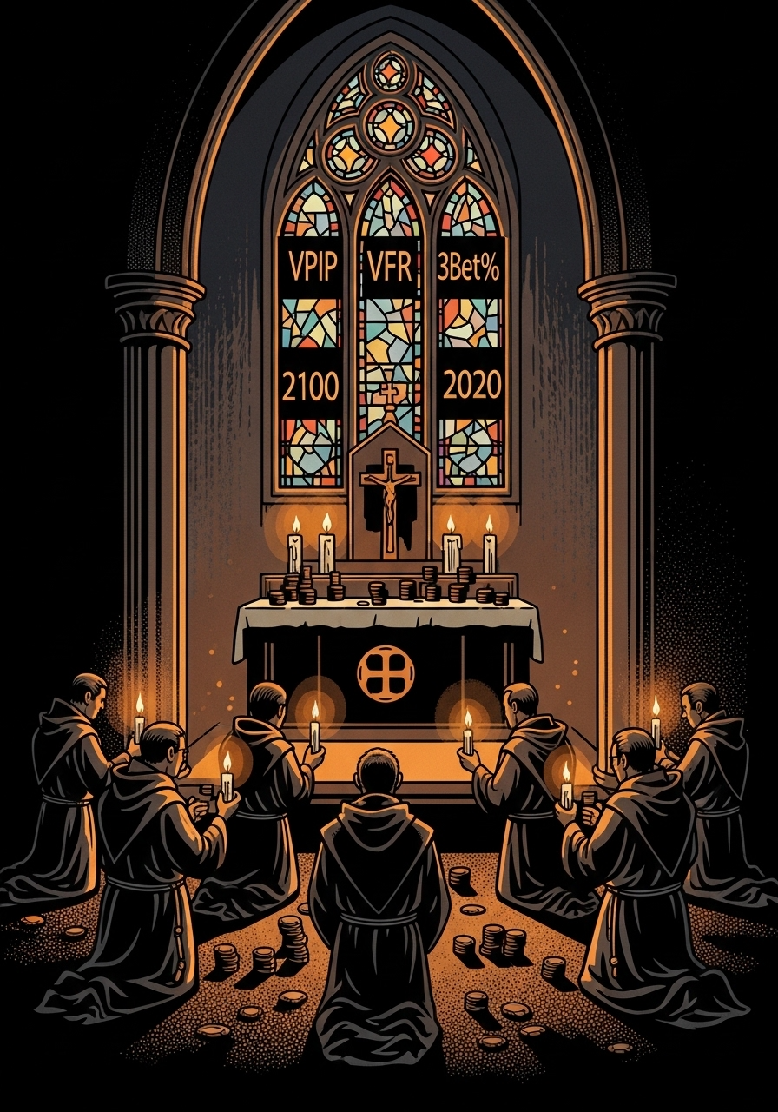
What we've been told
HUD stats worship — the standard poker-study gospel
• VPIP high → loose → bad player
• PFR low → passive → bad player
• Fold-to-3Bet high → tight → pays attention (good)
• AF low → weak → exploitable
• Wide gap (VPIP−PFR) → flatter → losing
• Every stat is a verdict. Every number tells you the skill.

Slide 3
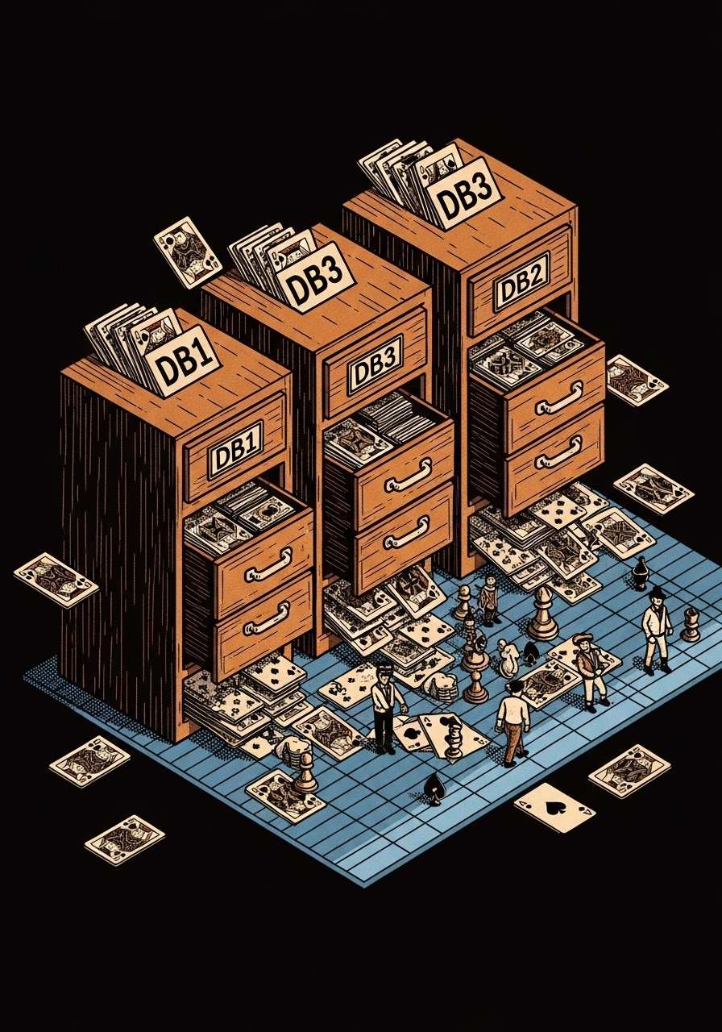
The sample
Real data, not textbook theory
• 4 tournament-player PokerTracker 4 databases
• bassguy + 3 uploaded friend DBs (ACR)
• 1,076 unique player names with ≥1,000 combined hands
• Deduped by player_name so shared hands don't double-count
• bb/100 measured from tourney_cache (pre-normalized by BB size)
• Players sorted by bb/100 and split into 10 equal deciles
• D1 = worst 10% · D5 = break-even middle · D10 = top 10%

Slide 4
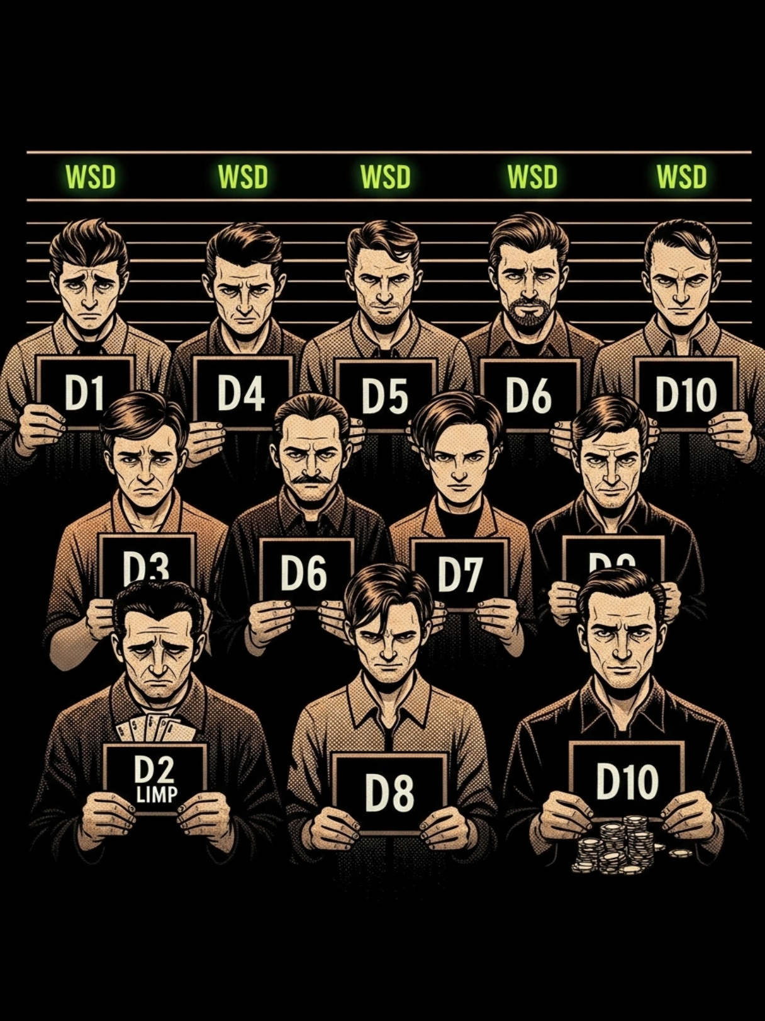
What the deciles actually look like
(winners vs losers, side by side)
Dec | bb/100 | VPIP | PFR | Gap | 3Bet% | F-3B% | WTSD | WSD | WSD−WTSD
D1 | -44.7 | 28.1 | 12.8 | 15.2 | 6.4 | 69.4 | 44.4 | 46.2 | +1.9
D2 | -17.1 | 24.4 | 12.4 | 11.9 | 6.4 | 74.4 | 45.2 | 48.4 | +3.2
D3 | -9.5 | 23.8 | 13.2 | 10.7 | 6.7 | 75.2 | 47.8 | 49.8 | +2.0
D4 | -4.4 | 23.1 | 13.5 | 9.7 | 6.8 | 76.8 | 48.4 | 51.8 | +3.4
D5 | +0.3 | 22.2 | 13.5 | 8.7 | 6.8 | 77.1 | 49.0 | 52.3 | +3.4
D6 | +4.5 | 22.4 | 14.4 | 8.0 | 7.2 | 76.3 | 48.2 | 53.1 | +4.9
D7 | +9.3 | 22.7 | 14.4 | 8.3 | 7.2 | 75.6 | 47.3 | 53.1 | +5.8
D8 | +15.2 | 23.6 | 14.6 | 9.0 | 7.2 | 76.6 | 46.4 | 53.8 | +7.4
D9 | +23.2 | 24.6 | 13.9 | 10.7 | 6.9 | 74.7 | 43.8 | 54.7 | +10.9
D10 | +45.3 | 26.5 | 14.1 | 12.4 | 6.8 | 72.1 | 42.7 | 54.2 | +11.5
Highlighted: D1 worst · D5 break-even · D10 best

Slide 5
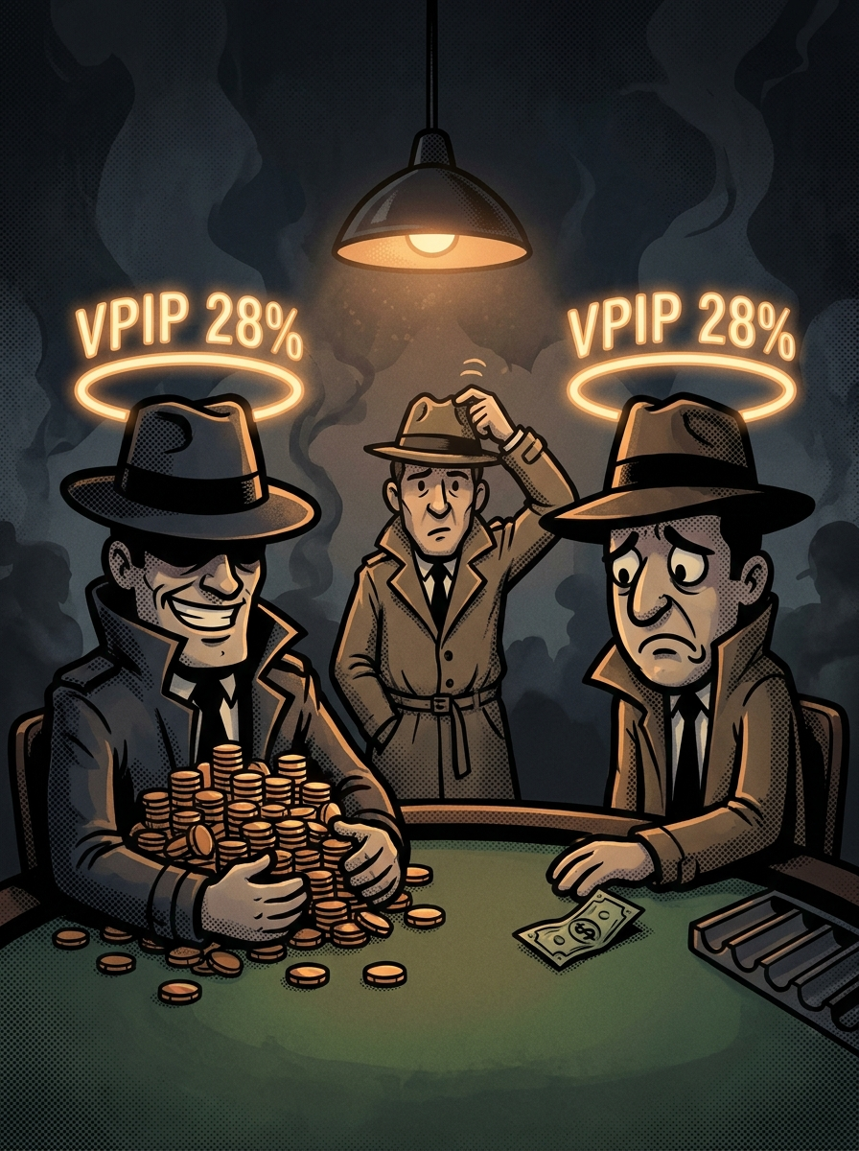
VPIP doesn't predict winning
Look at the U-shape.
Player type | VPIP
D1 — losers | 28.1
D5 — break-even | 22.2
D10 — winners | 26.5
Top winners play LOOSER than the
break-even middle.
A villain at 28 VPIP could be:
· a D1 losing station, OR
· a D10 winning LAG
VPIP alone cannot tell you which.

Slide 6

None of the solo stats work
U-shape or flat across the whole pool
Stat | D1 | D5 | D10 | Pattern
VPIP | 28.1 | 22.2 | 26.5 | U-shape
PFR | 12.8 | 13.5 | 14.1 | nearly flat
Gap | 15.2 | 8.7 | 12.4 | U-shape
3-Bet % | 6.4 | 6.8 | 6.8 | flat
Fold-to-3Bet % | 69.4 | 77.1 | 72.1 | inverse U-shape
Limp % | 6.7 | 4.7 | 5.2 | U-shape
"How often they do it" is style. Not skill.

Slide 7
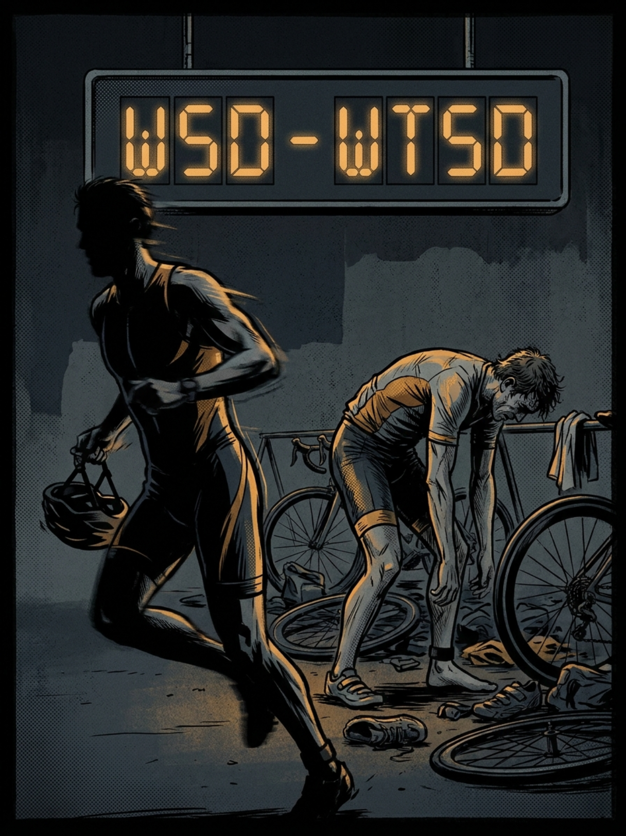
The one stat that IS monotonic
WSD — won-at-showdown %
7 of 9 decile steps go UP.
+8 points D1 → D10.
If you can only watch one
HUD stat, watch WSD.
A villain at WSD ≥ 54
is almost certainly a winner.
A villain at WSD < 50
is almost certainly a loser —
regardless of their VPIP.
Dec | bb/100 | WSD
D1 losers | -44.7 | 46.2
D5 mid | +0.3 | 52.3
D7 | +9.3 | 53.1
D10 winners | +45.3 | 54.2

Slide 8

WSD − WTSD: the compound signal
The gap between 'how often I show down' and 'how often I win there'
Dec | bb/100 | WTSD | WSD | WSD−WTSD
D1 | -44.7 | 44.4 | 46.2 | +1.9
D5 | +0.3 | 49.0 | 52.3 | +3.4
D10 | +45.3 | 42.7 | 54.2 | +11.5
8 of 9 decile steps UP. +9.6 from worst to best.
Losers bring junk to showdown. Winners are selective.
Break-evens over-attend showdown with mediocre hands.

Slide 9
Composition, not frequency
Two players at 28 VPIP — same number, opposite play
 | D1 losing rec | D10 winning reg
VPIP | 28 | 26
Opens | JTo, QTo, A9o, K9o | K9s, 87s, 65s, T8s
3-bet bluffs | A8o, A9o, 98o, 54s | K2s, Q5s, 65s, A6s
Calls 3-bet | AJo, ATo, KJo, A9o | 22-TT, 87s, 76s, T8s
Same VPIP number. Different hand composition. Opposite outcomes.

Slide 10
What DOES work for villain reads
Stats in PAIRS, not in isolation
Stat combo | What it means | Exploit action
VPIP high + WSD low | Calling station | Thin value. Don't bluff.
VPIP high + WSD high | Real LAG winner | Pot control. Respect aggression.
Gap wide + 3-bet low | Flatter losing style | Steal wide. C-bet dry boards.
Gap wide + 3-bet high | Aggressive bluff-3-better | Tighten opens. 4-bet light.
Fold-to-CBet < 45% | Station on defense | Value every flop. No bluffs.
F-CBet > 60% + F-3B > 80% | Paper tiger | 3-bet relentlessly.

Slide 11

The pool signature everyone shares
This one changes how you should play TODAY
Fold-to-3Bet% across every decile:
D1 | D2 | D3 | D4 | D5 | D6 | D7 | D8 | D9 | D10 | Solver target
69.4 | 73.8 | 75.1 | 72.5 | 77.1 | 79.7 | 76.4 | 76.3 | 74.7 | 71.5 | 55-65
Every decile is OVER-FOLDING to 3-bets vs solver targets.
The entire pool — losers, break-evens, AND winners —
is a 3-bet exploit.
If you're not 3-betting aggressively, you're leaving
money on the table across the whole skill spectrum.

Slide 12

The reframe
VPIP is a speedometer.
It tells you how fast.
WSD is the GPS.
It tells you where you're going.

Slide 13
Takeaways for the study group
• Stop describing villains with frequencies alone — it's style, not skill.
• Pair stats for real reads. VPIP × WSD. Gap × 3-bet. Fold-to-CBet × F-3B.
• Watch WSD if you can only watch one number.
• Your VPIP target is wrong — doesn't matter what it is.
• Range composition is the coaching axis, not frequency.
• 3-bet more. The whole pool is over-folding.
• Loose is just loose. Passive is just passive.
• Good or bad comes from WSD and what hands fill the range.

