Slide 1
Ranges Without Charts
How to calculate your hand at the table
Foundational Lesson 1 · facing a raise, a flat, and a squeeze

Slide 2
Why this matters — a real leak
Your own hands, June, 30bb+ · hands folded when it was your turn to open
▸ How often you fold a hand you're supposed to OPEN, by seat:
  – EP — 3% (clean: folding tight early is correct)
  – MP — 7%
  – CO — 18%
  – BTN — 23% ← the leak: nearly 1 in 4 openers thrown away
▸ The pattern: the leak GROWS toward the button — exactly where stealing pays most.
  – You've read the charts. The charts didn't fix it.
  – A method you can run at the table will.

Slide 3
The one idea
Everything else hangs off this
▸ Every voluntary action narrows AND strengthens the range.
  – The OPENER holds the widest, weakest-average range at the table.
  – Anyone who continues — call or raise — is choosing a subset of their range.
  – So a continuer is ALWAYS stronger on average than the opener.
▸ That is your leverage: when you continue behind an opener, your hand quality
  – beats his by default. You just have to know how much, and with which hands.

Slide 4
A call is a capped middle
The single most useful read in poker
▸ When a player just CALLS (doesn't 3-bet), they sell off two ends:
  – the TOP — premium hands would have 3-bet
  – the BOTTOM — junk would have folded
▸ What's left is a dense MIDDLE — lots of good hands, but no nuts.
  – Leverage: they have more strong hands per square inch than the opener.
  – Vulnerability: they can't have the nuts — so they can be blown off the top.
▸ Hold both at once. It's why a caller has flop power AND why a squeeze works.
Imagine the toy game, RFI could have Ace, king or Queen. The caller is almost forced to have the King. The squeeze attacks the flat and takes the top hands from the RFI.

Slide 5
The four zones
Sort by ROLE, not by rank — this is the picture you carry
AA
AKs
AQs
AJs
ATs
A9s
A8s
A7s
A6s
A5s
A4s
A3s
A2s
VALUE
get it in / 3-bet
AKo
KK
KQs
KJs
KTs
K9s
K8s
K7s
K6s
K5s
K4s
K3s
K2s
AQo
KQo
QQ
QJs
QTs
Q9s
Q8s
Q7s
Q6s
Q5s
Q4s
Q3s
Q2s
REALIZE
suited body — flat, see flops
AJo
KJo
QJo
JJ
JTs
J9s
J8s
J7s
J6s
J5s
J4s
J3s
J2s
ATo
KTo
QTo
JTo
TT
T9s
T8s
T7s
T6s
T5s
T4s
T3s
T2s
A9o
K9o
Q9o
J9o
T9o
99
98s
97s
96s
95s
94s
93s
92s
BLUFF
offsuit broadways — pressure
A8o
K8o
Q8o
J8o
T8o
98o
88
87s
86s
85s
84s
83s
82s
A7o
K7o
Q7o
J7o
T7o
97o
87o
77
76s
75s
74s
73s
72s
AMBUSH
nut-blocker aces — trap / 3-bet bluff
A6o
K6o
Q6o
J6o
T6o
96o
86o
76o
66
65s
64s
63s
62s
A5o
K5o
Q5o
J5o
T5o
95o
85o
75o
65o
55
54s
53s
52s
A4o
K4o
Q4o
J4o
T4o
94o
84o
74o
64o
54o
44
43s
42s
Position is the cue too: value top-left, bluff below it, ambush top-right, realize the body.
A3o
K3o
Q3o
J3o
T3o
93o
83o
73o
63o
53o
43o
33
32s
A2o
K2o
Q2o
J2o
T2o
92o
82o
72o
62o
52o
42o
32o
22

Slide 6
Width = half, then slide
Read ONE number: how wide did the opener come in? (solver, 40bb)
Seat | Opens
EP | 18%
MP | 25%
HJ | 27%
CO | 37%
BTN | 51%
SB | 35%
▸ Then continue about HALF his width — and slide with position:
  – Right behind him: ~half (solver: 52% of his range)
  – Middle seats: ~80–90%
  – On the button: 120% — WIDER than he opened (position pays)
▸ Early, your edge is a STRONGER range. Late, your edge is POSITION.
▸ Blinds: price widens you more — but stay 3-bet-or-fold out of position.

Slide 7
The squeeze — the sandwich
The messiest spot has the SIMPLEST rule
▸ A raise AND a caller in front of you. Picture the two ranges:
  – Opener = WIDE but uncapped (can still have aces)
  – Caller = a capped MIDDLE (dense, no nuts, no trash)
▸ Your value squeeze must beat BOTH — and because it has to beat an uncapped
  – opener from ANY seat, the value core barely changes seat to seat.
  – The gift: memorize it once, use it everywhere → Value + top of Ambush.
  – Flat almost nothing. Turn up the bluffs only as the opener gets wider.

Slide 8
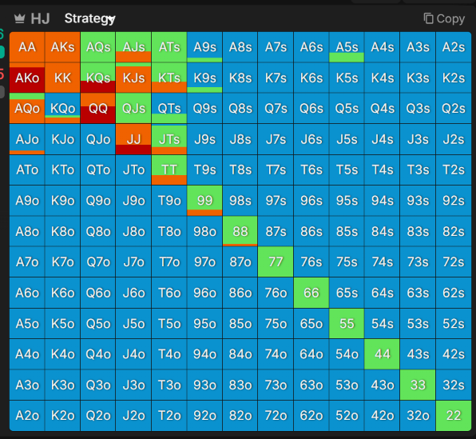
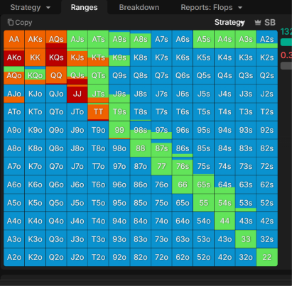
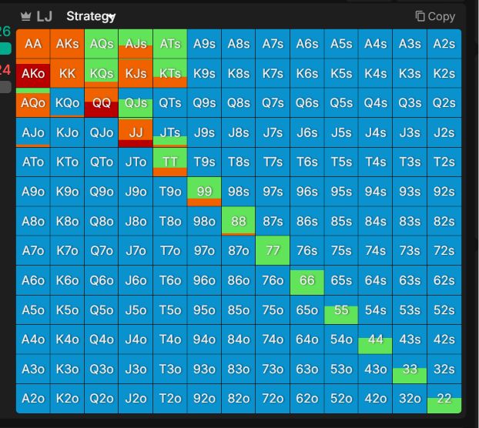
The squeeze range — shown
One grid, shaded by how many opening seats squeeze each hand
It barely moves.
LJ and HJ are IDENTICAL — same hands, exactly.
LJ → BTN shift by only a card or two.
Only the blinds widen — price + closing action,
the same exception you've seen all lesson.
Takeaway: learn this ONE shape, use it from any seat.

Slide 9
The method — put it together
One input · one picture · one slider
▸ 1. INPUT — how wide did the opener come in? tight / standard / wide.
▸ 2. PICTURE — spend your continue top-down through the zones:
  – Value always → Realize as far as position allows → Ambush as 3-bets → drop Bluff.
▸ 3. SLIDER — half behind him, wider with position, past parity on the button.
▸ Worked example:
  – CO opens (wide-ish). You're on the button → all Value, a big slice of Realize
  – (you're IP), nut-blocker Ambush as 3-bets. Offsuit junk folds.
  – A blind cold-3-bets = squeeze on you → collapse to Value + top Ambush, fold the rest.

Slide 10
The honest takeaway
A good method knows its error bars
▸ This gets you ~90% right — not solver-perfect.
  – It nails your WIDTH and your ROLES.
  – It won't reproduce exact mixed frequencies. That's fine.
▸ For a live player: "roughly right, every hand" beats "perfect, never."
▸ Memorize ONE thing — the opener-width ladder. Everything else you derive.
  – Then drill it: open-fold spots, weighted to CO and BTN, at 40bb.

