Slide 1

The C-Betting Blueprint
The GTO baseline — and where the pool leaves the map
Medium-to-deep-stack play (~25bb+). Short-stacked it’s push/fold — this doesn’t apply.

Slide 2

ACT 1 · THE GTO BASELINE
C-Bet Is a Tool, Not a Reflex
The myth: “I raised, so I bet.”
GTO c-bets ~60–70% after an open — betting more is habit or myth. 30–40% of the time, betting is a mistake.
Two pillars decide it:
• Range Advantage — more overall equity (grows toward the button, vs the blinds).
• Nut Advantage — more 2-pair-and-better (depends on the flop).

Slide 3
ACT 1 · THE GTO BASELINE
Range × Nut → Frequency & Size
R A N G E →
High Range · Low Nut (A72r)
Bet OFTEN, SMALL — realize equity, protect
High Range · High Nut (KQ9)
Bet OFTEN, LARGE — extract max value
Low Range · Low Nut (922)
CHECK — preservation mode
Low Range · High Nut (987hhd)
Bet RARELY, LARGE — polarized
N U T A D V A N T A G E →

Slide 4
ACT 1 · THE GTO BASELINE
Position & Texture Set the Rules
Out of position — constricted: check-heavy in single-raised pots.
In position — expansive: bet dry/high boards and 3-bet pots.
Dry / high-card / 3-bet pots → small (25–33%).
Wet / low / connected → large & polarized (66–75%).
3-bet pots: the IP raiser owns ~85% of the nut advantage.

Slide 5
ACT 1 · THE GTO BASELINE
When GTO Hits the Brakes
Even with the range lead, the solver CHECKS when:
• Extreme ICM pressure — a bigger stack can bust you.
• The pot is multiway — equity drains fast.
• A low, connected board favors the caller.
• Betting invites a costly check-raise.
Knowing when to check is how tournaments are won.

Slide 6

That’s GTO. Now — the pool.
The solver assumes a defender who plays back correctly.
This pool doesn’t. Five deviations — and each one is money.

Slide 7

ACT 2 · POOL DEVIATION 1
They Just Fold
The pool folds to a flop c-bet ~50% of the time.
The solver never prices that in — it assumes correct defense. So fold equity is a THIRD driver the two pillars miss.
EXPLOIT: c-bet more often — a bet that isn’t “correct” vs a balanced player still prints against a folder.
But check first if a trap earns more: betting folds them out — a check can keep them firing (see Deviation 2).

Slide 8

ACT 2 · POOL DEVIATION 2
They Stab Our Checks
Check as the raiser and the pool bets into us ~42% — often with nothing.
So checking OOP isn’t surrender — it’s a TRAP: let them stab, then take it away.
When they check back instead → probe the turn.
Still range-c-bet where we keep the nuts (the rifle):
• High-card dry • Two-broadway
• Paired — except ace-catch-up (AQQ, AKK) + low blanks (AA2, KK2)

Slide 9

ACT 2 · POOL DEVIATION 3
They Fold to SIZE, Not Strength
The pool calls “normal” bets to see cards — but folds to pressure.
(Remember when we did this: “second pair, they bet half — I call.”)
Same hand vs a 3-bet: folds 37% to a small one, 62% to a big one.
The middle sizes (⅓–½) get called and deny nothing.
EXPLOIT: bet pot / overbet for folds, or check. Skip the medium bet.

Slide 10

ACT 2 · POOL DEVIATION 4
Their Check-Raise Is Rare & Honest
The pool check-raises a c-bet only ~14% — value-heavy, almost no bluffs.
The “24% trap” the books warn about is half the size — and it isn’t bluffing.
EXPLOIT: when it comes, believe it — overfold our bluff-catchers. Until then, keep firing.

Slide 11
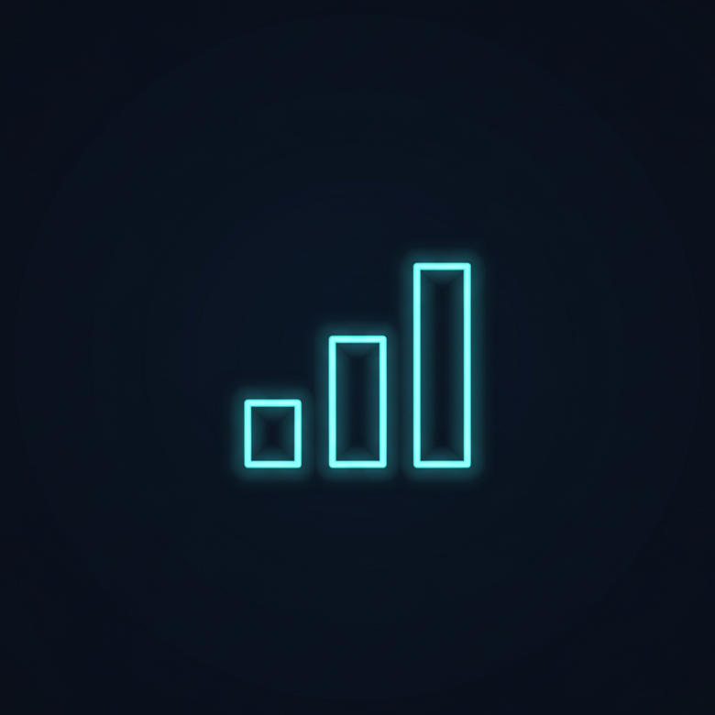
ACT 2 · POOL DEVIATION 5
The Pool Barely Changes by Stake
Fold-to-c-bet is flat across buy-ins: ~50% at the micros, the mid, and up.
If anything the bigger game is SAFER — it raises c-bets less and stabs checks more.
So the same exploits travel UP in stakes. No different game per level.

Slide 12
GTO is the servant. The pool is the exam.
The baseline tells us the default. The deviations tell us where the profit is.
Build the engine — then read the room.

