Slide 1


BB Defense at 20bb
What the population gets wrong vs what wins money
Data: 3.87M hero-action rows · 6 tournament players · 5 years Reference: 20bb chipEV solver (2.3× opens)

Slide 2
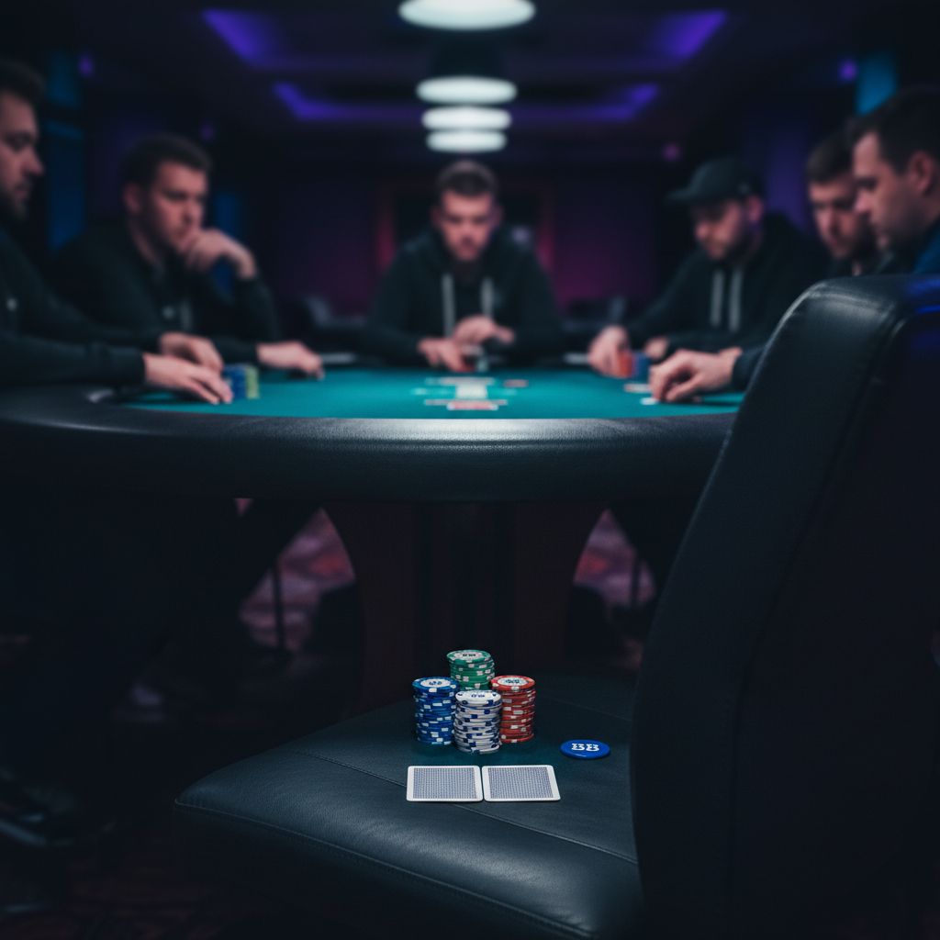
The leak in one number
−45 BB / 100
what BB defending in late-stage MTT at 20bb effective costs the pool
9,936 hands in discovery (replicates on 4,223-hand confirmation set) All 6 players lose money in this spot Slacker excluded: −59 BB/100 — removing the largest sample makes the leak worse, not better Negative across all 10 chronological splits — not noise, not a tilt phase

Slide 3

What the solver wants · What the pool does
20bb chipEV solver · BB facing a 2.3× open
Opener | Solver defends | Pool defends | Gap
EP | 90% | 45% | −45 pp
MP | 92% | 44% | −48 pp
CO | 95% | 43% | −52 pp
BTN | 100% | 44% | −56 pp
SB (heads-up) | 53% | 42% | −11 pp
Solver never folds against a button open. Pool folds 56% of the time.

Slide 4
Two leaks, not one
LEAK #1
LEAK #2
Over-folding by frequency
Slow-playing instead of jamming
Pool folds 56% vs CO. Solver wants 5%. Even after realistic ICM and skill adjustments (~70% target), pool is 25 percentage points too tight.
Vs SB raise heads-up, solver shoves 16%. Pool jams 6%. Premium pairs and AK that should be 3-bet jamming for value are getting flat-called or small-raised instead.
+ a 3% small-raise rate that's GTO-illegal at 20bb (only call or shove are correct sizes)

Slide 5
Where the over-fold lives — hand-by-hand
Solver wants 100% defense vs CO open. Pool folds anyway.
Hand | Solver action | Pool defends | Pool folds
K3o | always call | 11% | 89%
Q3o | always call | 8% | 92%
J3o | always call | 8% | 92%
T3o | always call | 3% | 97%
73o | always call | 3% | 97%
93o | always call | 1% | 99%
Solver is aggressive at the very bottom — a realistic adjusted target wouldn't ask you to defend 93o either.
But the gap exists at every hand class above this too.

Slide 6

Empirical proof that jamming wins
Not just solver theory — what actually happens when our pool jams the solver's shove range
Spot | Action | Sample | Avg BB won
vs CO open | jam | 157 | +4.81
vs CO open | small raise | 78 | +3.48
vs CO open | fold | 11 | −1.11
HU vs SB | jam | 109 | +5.33
HU vs SB | small raise | 26 | +4.40
HU vs SB | fold | 15 | −1.11
HU vs SB | flat-call | 1 | −26.61
Empirical jam-vs-fold gap is roughly +6 BB per hand. Across ~5% of all BB spots, that's ~30 BB / 100 of recoverable winrate.

Slide 7
What if the CO/BTN is tight?
Stress test: even when villain CALLS the jam, BB still profits
ALL BB JAMS · CO / BTN OPEN · 20-40 BB
SOLVER SHOVE RANGE ONLY · CLEAN TEST
Opener | Jams | Fold % | Call % | BB when called | Overall
CO | 290 | 60% | 40% | +1.62 | +2.93
BTN | 270 | 67% | 33% | +4.04 | +3.81
Premium pairs (TT+) + AK + suited broadway
Opener | Jams | Fold % | BB when called | Overall
CO | 157 | 64% | +6.56 | +4.81
BTN | 135 | 70% | +7.07 | +4.75
Even when villain CALLED the jam — exactly the "tight CO has me beat" scenario — BB averaged +1.62 BB (CO) and +4.04 BB (BTN) per called hand.
Jamming the right range gets called ~35% of the time. When called, BB averages +6.56 BB on top of preflop dead money. Tight villain calls = coin-flip range vs range = still +EV after dead money.
The "I won't shove against tight CO" objection fails empirically. Even in the called-jam subset alone — the worst case — BB still wins +1.62 BB/hand (CO) and +4.04 BB/hand (BTN).

Slide 8
Of the hands they DO defend, which lose money
Hand group | Hands | BB / hand
Suited connectors (JTs–54s) | 439 | −1.02
Offsuit junk (K7o, Q7o, T7o…) | 1,365 | −1.16
Offsuit weak Ax (A2o–A9o) | 913 | −0.69
Mid pairs 55–88 | 678 | +0.54
Roosters (AQo–ATo) | 871 | +0.79
Mad Kings (KQo–K9o) | 1,133 | +0.09
Hands that need 3 streets to evolve bleed. Hands that play themselves on the flop win.

Slide 9
Showdown reality check
When pool defends and reaches showdown — what wins?
Hand group | Reach SD | Win % at SD | Avg BB at SD
Dictators (KK, QQ) | 33% | 74% | +11.52
Guards (JJ, TT, 99) | 23% | 71% | +7.85
Roosters (AQo–ATo) | 18% | 63% | +3.80
Eagle (AKs/AKo) | 25% | 62% | +5.90
— premium / made-hand line —
Justice League (suited connectors) | 13% | 48% | +1.89
Lottery Tickets (suited rags) | 11% | 45% | +1.10
Turkeys (weak Ax) | 13% | 55% | −0.85
Fighting Kings (K8s–K2s) | 12% | 47% | −1.36
Pool defends with Fighting Kings (K8s–K2s) — when they reach showdown, they LOSE on average.

Slide 10
Same spot, opposite outcomes
Why some clusters win at showdown and others bleed — same depth, same opponents
FAILING BINARY (LOSE)
STRICT BINARY (WIN)
Should be playing flush-or-fold / commit-or-fold.
Instead peeling, pairing turn, calling river.
Pocket pairs. Set-or-fold rule.
They only reach SD with strong made hands.
Cluster | Reach SD | Win at SD | Avg BB
Justice League (suited conn.) | 13% | 48% | +1.89
Lottery Tickets (suited rags) | 11% | 45% | +1.10
Zombies (offsuit junk) | 11% | 47% | −0.17
Fighting Kings (K8s-K2s) | 12% | 47% | −1.36
Cluster | Reach SD | Win at SD | Avg BB
Underground (22-44) | 9% | 60% | +4.42
Working Class (55-88) | 14% | 57% | +3.28
Guards (JJ-99) | 23% | 71% | +7.85
Dictators (KK, QQ) | 33% | 74% | +11.5
All sub-50% win at SD. They're showing up at the river with one pair against a range that has them beat.
All clear-50% win at SD. They flop a set or fold pre/flop. The hand makes the decision easy.
The leak isn't bad luck at showdown. It's arriving at showdown with the wrong hands.
Draws should be played binary — the population fails to. Pocket pairs play binary by default — and win.

Slide 11
The framework: clear vs messy decisions
CLEAR DECISIONS — WINS
MESSY DECISIONS — BLEEDS
Small pairs short → flop a set or fold. Binary. Weak Ax short → flop the ace or check-fold. Binary. Suited rags short → flop the flush draw or fold. Binary — even weak suited junk does fine.
Suited connectors short → flop pair-plus-gutshot, two-pair, or top-pair-no-kicker. Multiple medium-confidence outcomes. Bleed by paying off one bad street. Offsuit junk short → flop top pair with no kicker. Same problem — too short to fold, not deep enough to commit correctly.
The 20bb stack is the worst depth for hands that ask you to think postflop.

Slide 12
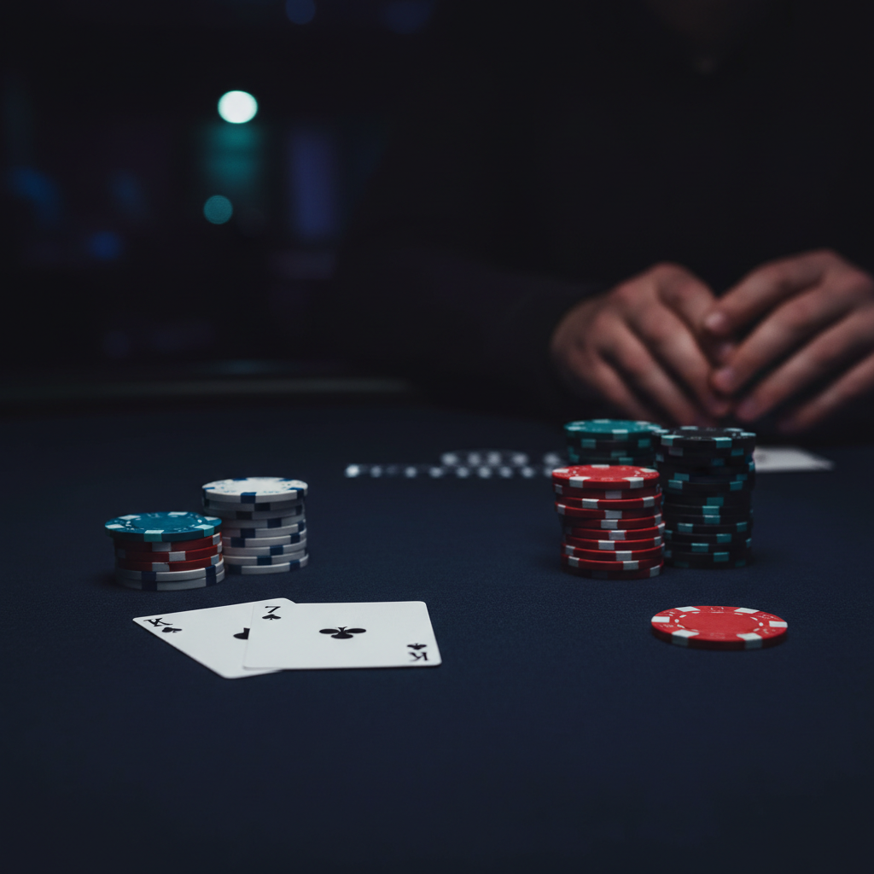
Example 1 — the typical fold
K7o · BB · 21 BB effective · late-stage MTT
Folds around to LJ. LJ min-raises (2 BB). Folds to BB. → BB calls. → Flop comes K-high. → BB checks. → LJ c-bets ~75% pot. → BB folds. Lost 2.1 BB.
Pair of kings is dominated by KQ/KJ/KT in LJ's open range. Calling preflop and check-folding the flop is the modal outcome with this hand. Hundreds of these per player.

Slide 13
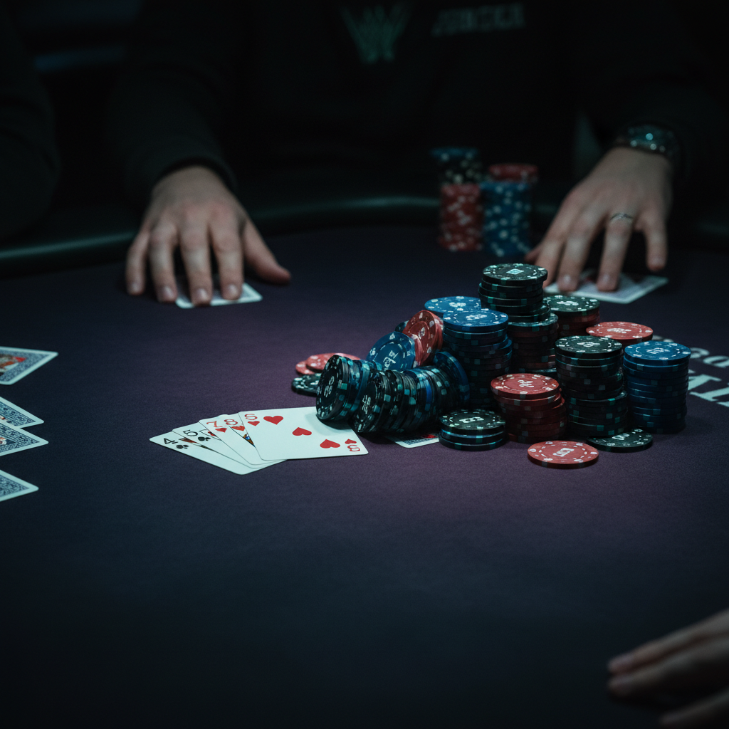
Example 2 — the disaster
T7o · BB · 25 BB effective · late-stage MTT
HJ opens 2×. Five players fold. BB calls. Flop comes connected, two-tone. → Hero floats with bottom pair plus a backdoor draw. → Turn brings a third heart. Hero check-calls a half-pot bet. → River completes the flush. → Hero check-jams. Villain calls with the made flush. Lost 25.4 BB in one hand.
The 2 BB call preflop turned into a 25 BB disaster across three streets of "I can't fold now" decisions.
The Zombies cluster bleeds because every hand has the same shape.

Slide 14
Caveats before you act on this
The chipEV solver isn't real life:
⚠ NO ICM
⚠ 2.3× OPENS
⚠ OPTIMAL POSTFLOP
Solver is chipEV — no payout-jump pressure. Real bubble pressure tightens defense by ~25 percentage points.
Solver assumption. Pool faces 2.5–3× more often at 20 BB in turbos. Bigger opens require more equity to defend.
Solver's other assumption. Real players misplay marginal calls. The chipEV-positive call becomes EV-negative when you can't realize the equity.
Realistic adjusted target: ~70% defense vs CO/BTN at 20 BB. Pool's 44% is still well below that.

Slide 15
Adjustment + bottom line
Three changes that recover real winrate
1.
Defend wider
Closer to 65–75% vs late-position opens — not 44%.
2.
Defend with the right hands
Keep suited broadway and dominating Ax. Drop suited connectors and offsuit one-gappers when not deep enough to realize them.
3.
3-bet jam premiums HU vs SB
KK, AA, AK, QQ, TT, JJ should be jam, not flat-call. Data confirms +5.33 BB per hand jamming this exact spot.
BOTTOM LINE
Pool's instinct that BB defense at 20 BB is bad money is partly correct — they can't realize the equity, so they fold. But they're folding the wrong hands AND slow-playing the right ones. Fix both halves and recover ~2 BB per 100 of total winrate.

