Slide 1

Apparent GTO vs Real GTO
C-betting g0 connected boards vs the Big Blind (40bb)
Study-group discussion — working hypotheses from GTO Wizard, validation in progress

Slide 2
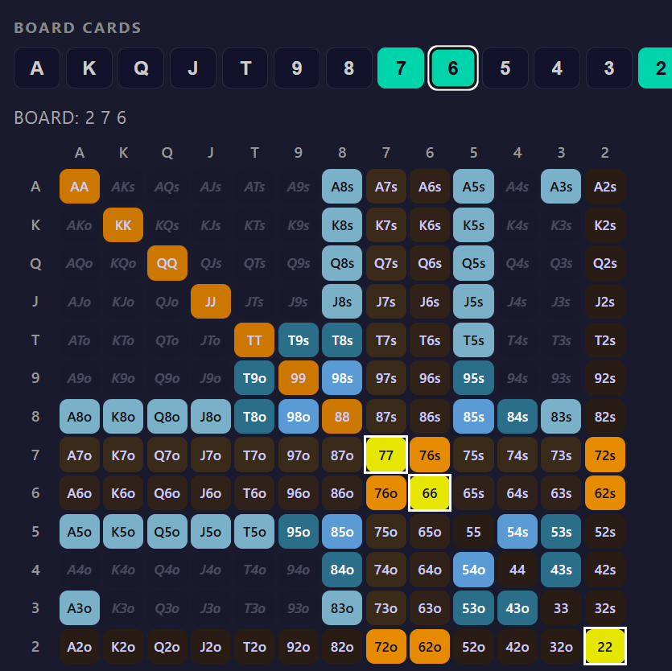
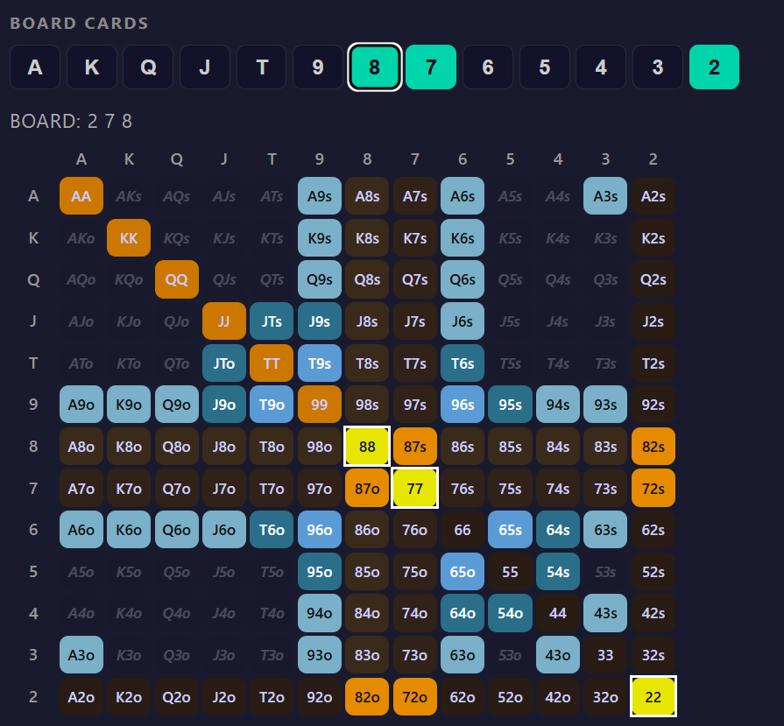
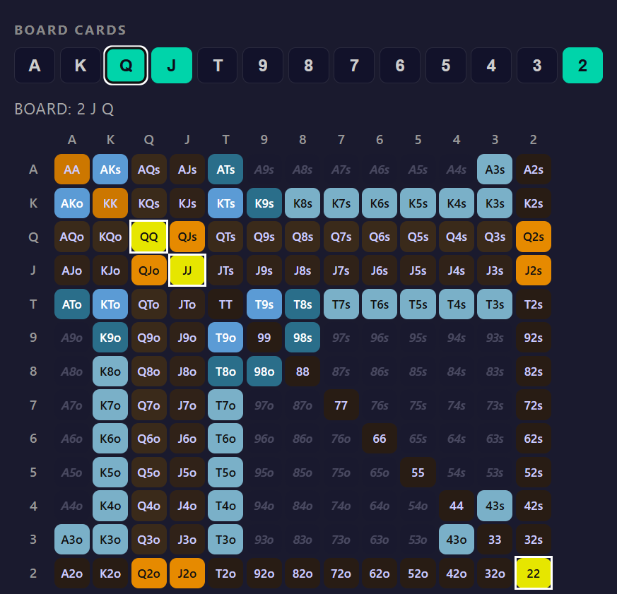
ISO PRIMER · 1 of 3
1,755 flops -> ~50 shapes
22,100 flops. Suit-relabeling collapses them to 1,755 distinct ones — still unmemorizable.
The claim: most play the SAME if you describe them by structure, not rank.
A deck has exactly 40 straight flushes — not 40 things to memorize. One shape (5-in-a-row) slid through 10 windows x 4 suits.
Flops work the same way: a handful of shapes, slid.

Slide 3
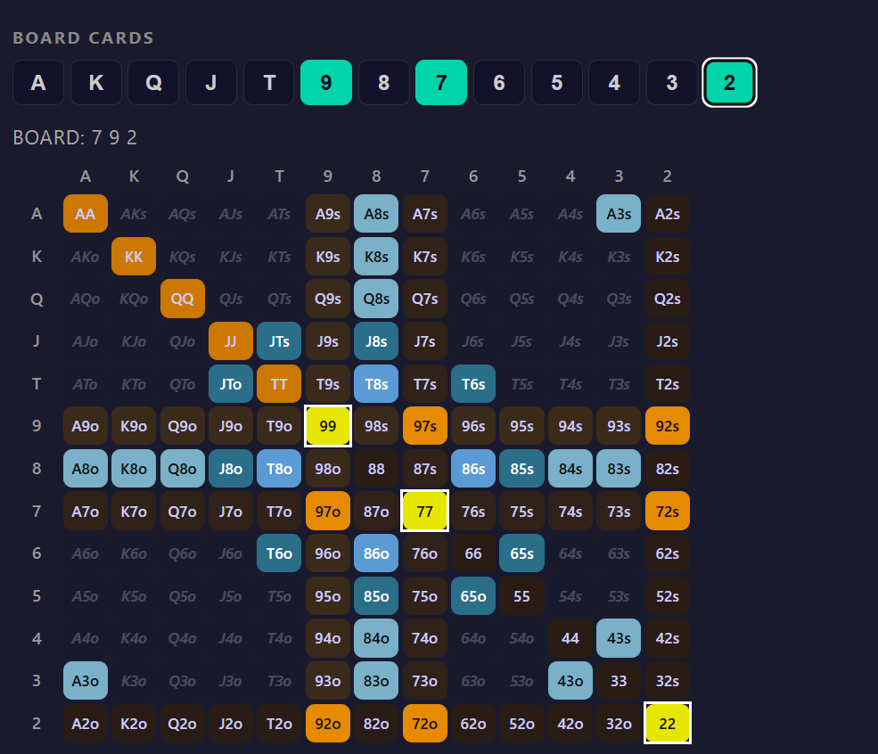
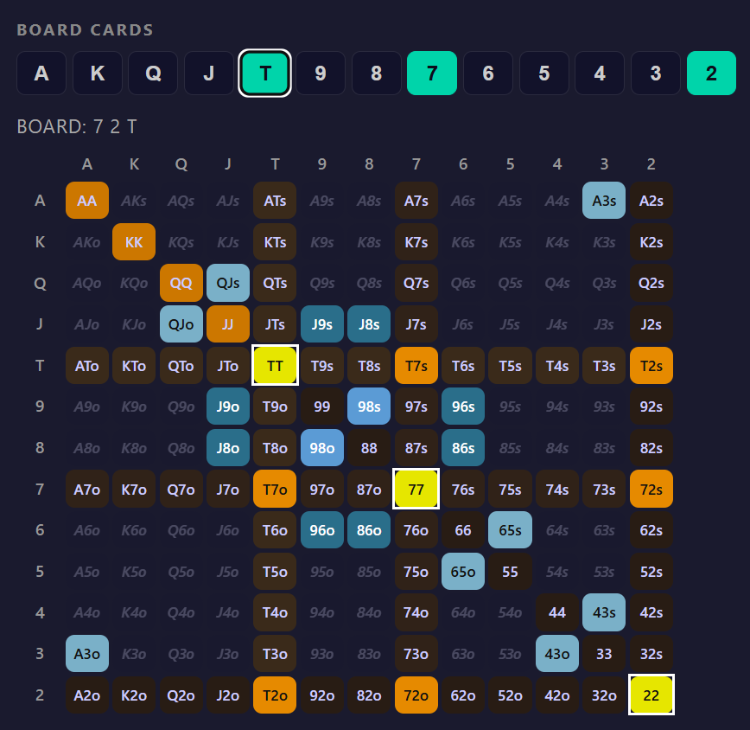
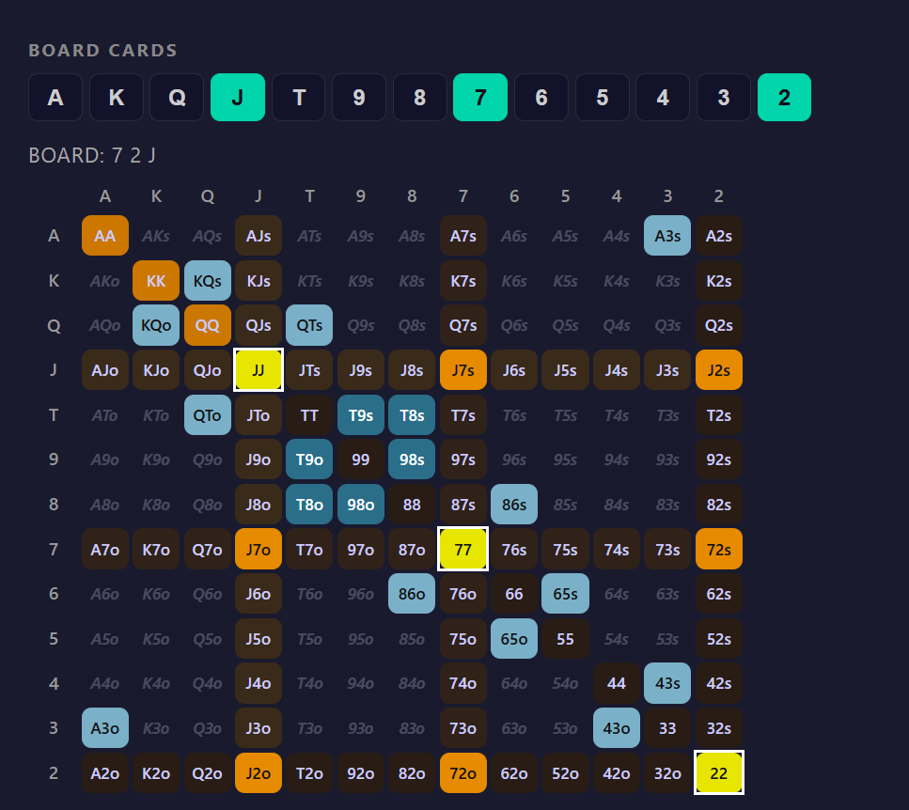
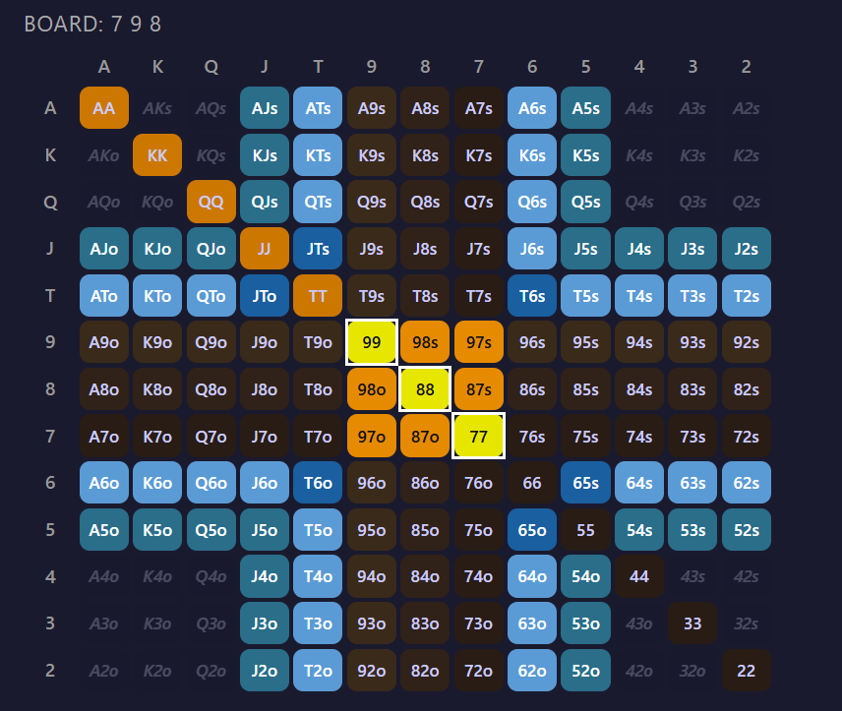
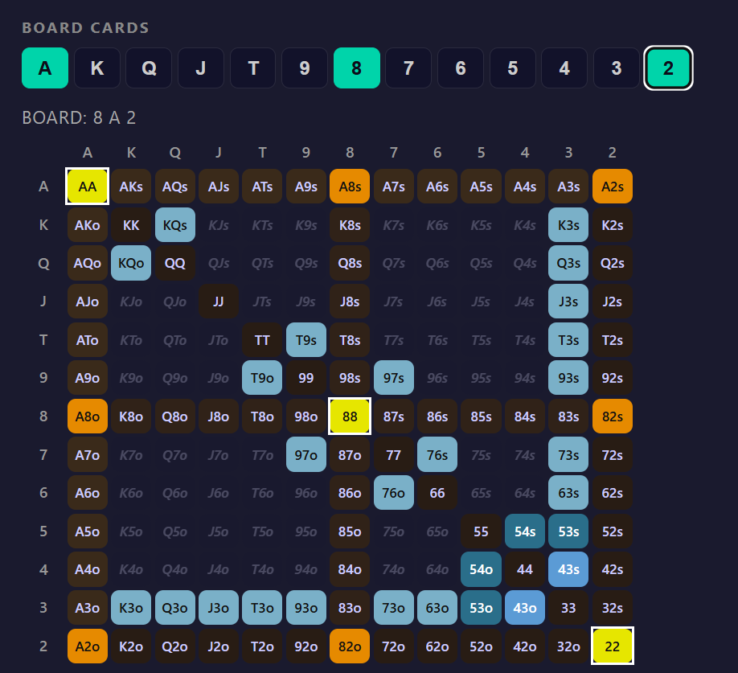
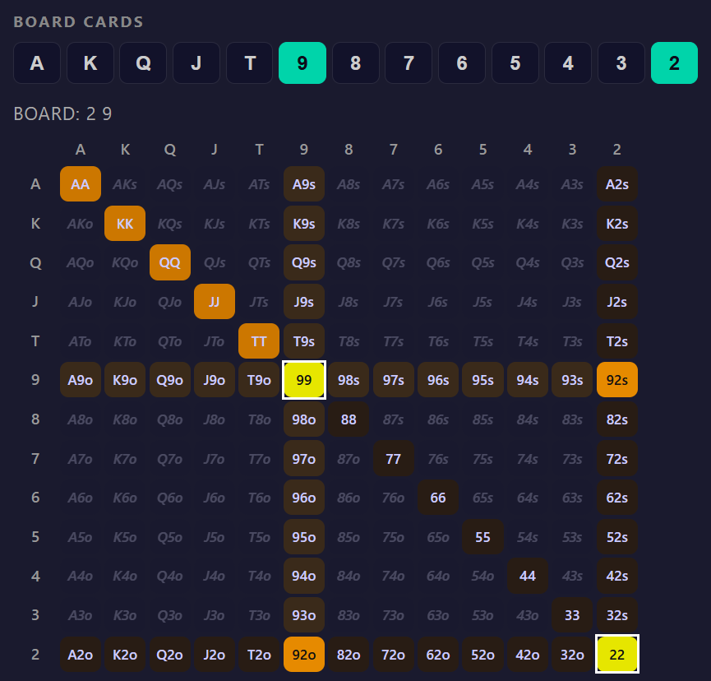
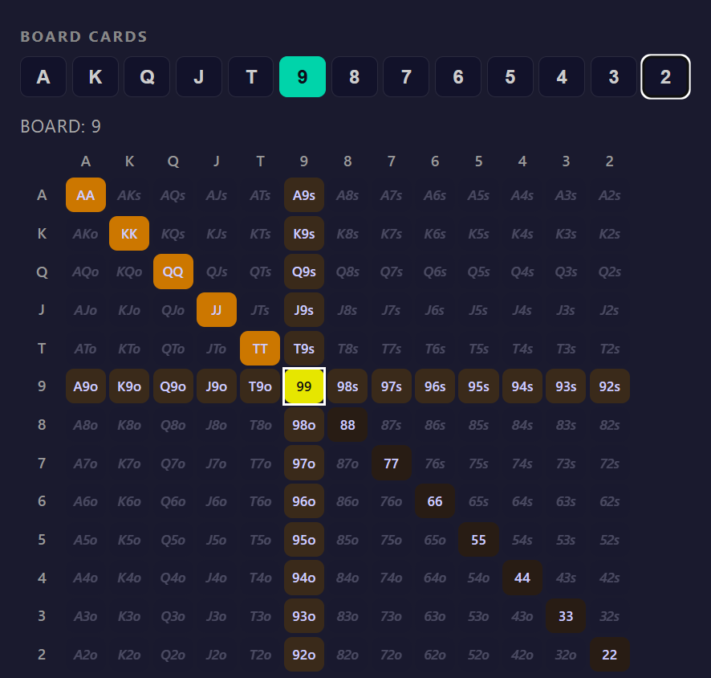
ISO PRIMER · 2 of 3
g0
Three coordinates: Shape x Band x Suit
g1
SHAPE — the skeleton: connected cluster / cluster+dangler / cluster+crown / disconnected / paired / trips.
g0 = a 2-card connected cluster (76, 87, 98...) — what this whole deck is about.
BAND — how high it sits (Ace / Broadway / Mid / Wheel). This is THE SLIDE.
SUIT — rainbow / two-tone / monotone.
Any flop = one (Shape, Band, Suit). ~50 combos cover all 1,755.
g2
g3
RUN
DRY
PAIRED
TRIPS

Slide 4
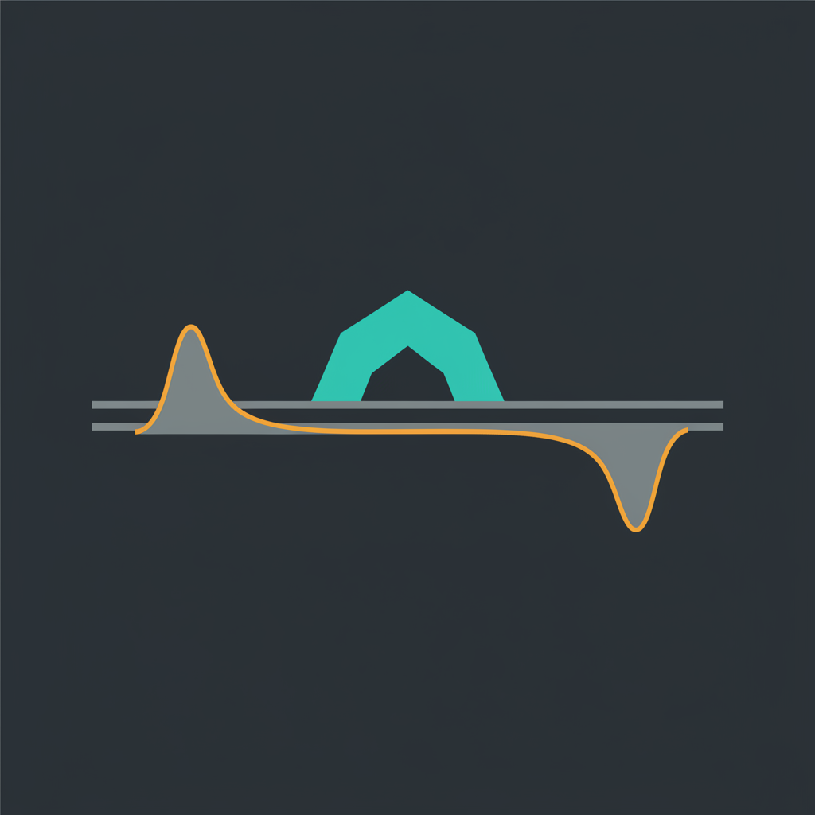
ISO PRIMER · 3 of 3
Shape stays, the band slides — that's the game
The shape never changes. Sliding it changes WHERE it sits in each player's range.
76x lives in the caller's range; slide it up to KQx and it's the opener's. Geometry fixed; strategy moves because the two ranges aren't rank-symmetric.
The dangler is nearly inert (pairing it tops out at bottom pair / bottom set). The cluster's slide is what moves strategy.
Everything after this: watch one shape slide, watch the c-bet regime change.

Slide 5
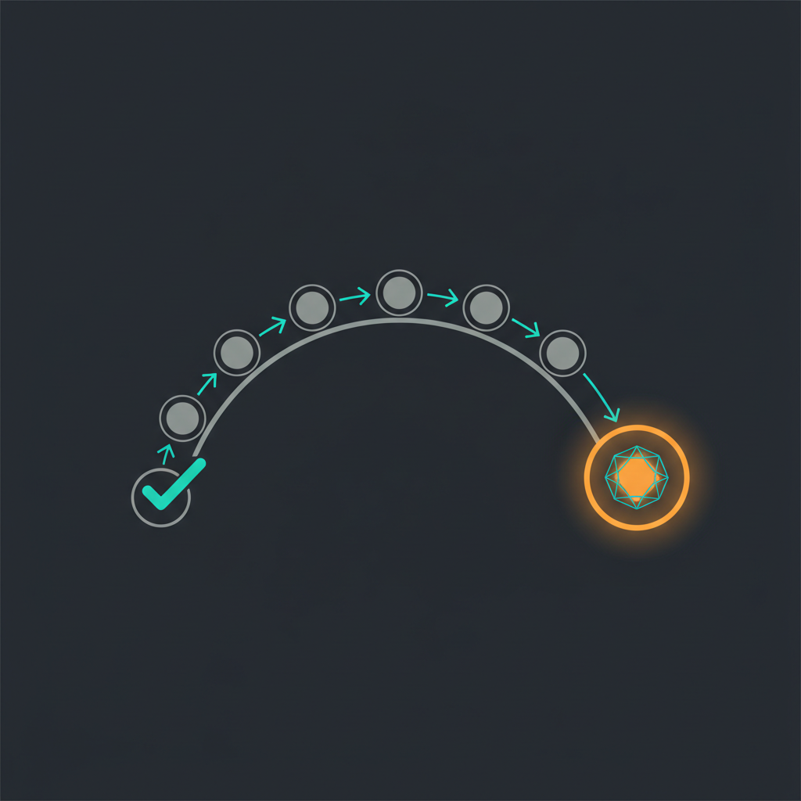
THE EXPERIMENT
The spot — held constant
UTG...BTN opens, BB calls, flop, BB checks, hero decides.
g0 connected + low dangler (76x -> AKx), rainbow, 40bb.
One node — flop c-bet after BB checks. Everything else held constant so the slide is the only variable.
All numbers = GTO Wizard solves.

Slide 6
“You c-bet small with your whole range on these boards.
That's GTO… right?”
Poll the room. Don't answer yet.

Slide 7
THE BAND SLIDE · 40bb, UTG vs BB
It's not a dial — it's a valley with regimes
GTOW-observed. The cluster climbs left->right; check% spikes then collapses.

Slide 8
READ THE CURVE
The strategy changes KIND, not just degree
762 · 872 · 982
SITUATIONAL / POLAR
Huge check. The board lives in BB's range — you don't own it.
T92
TRANSITION
The regime is flipping underneath you.
JT2
RANGE-BET FLOOR
Check ~0. Your range smashes — bet it all, small.

Slide 9
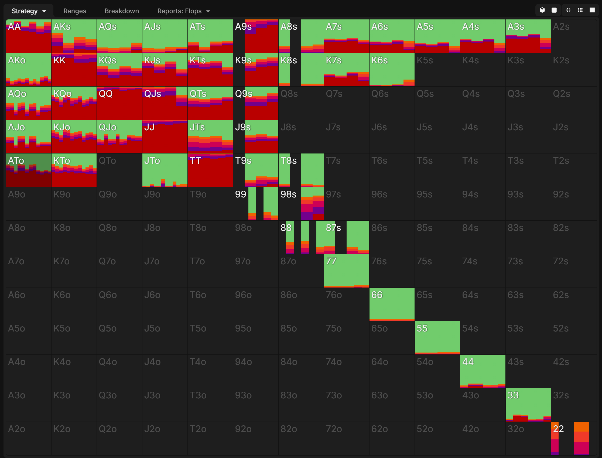
ZOOM · THE LOW BOARDS
Low = barbell (982, UTG, 40bb)
Fat ends, hollow middle. Overbet the value + selected bluffs, check the rest. No middle. (GTOW-observed)

Slide 10
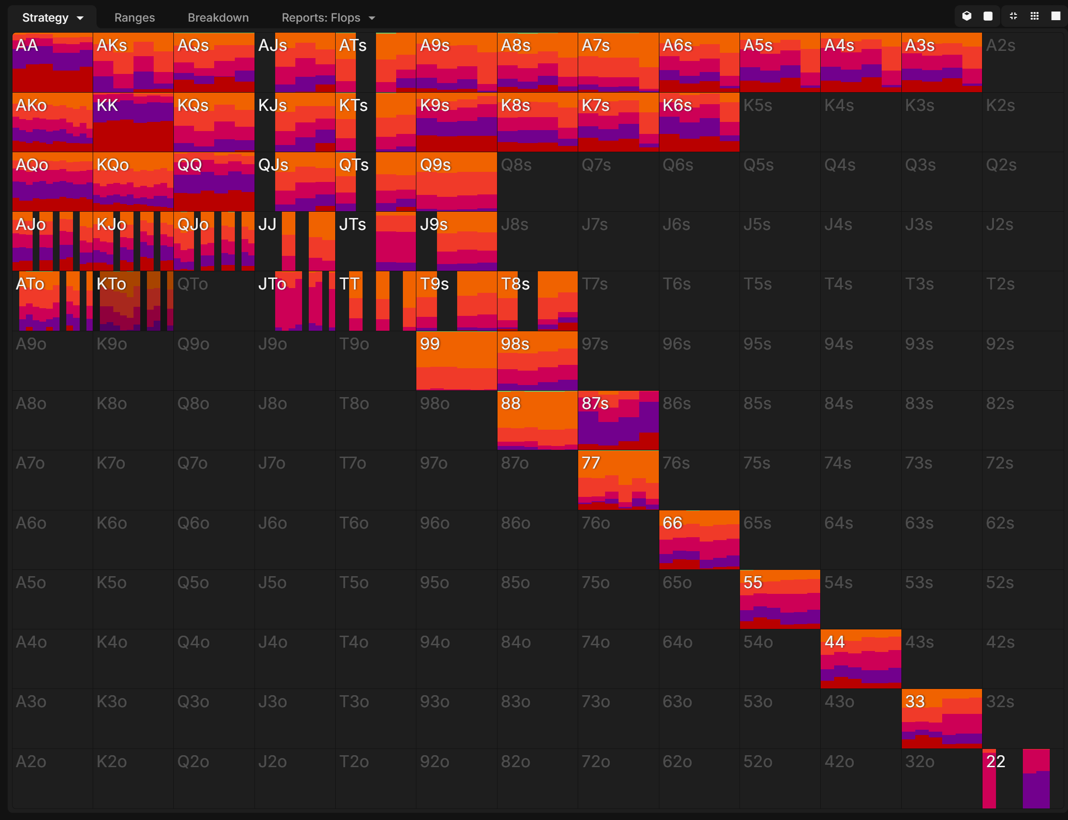
ZOOM · THE HIGH BOARD
High = pure range-bet (JT2, UTG, 40bb)
Check ~0. Bet everything, small. The ONLY board where 'c-bet everything' is correct. (GTOW-observed)

Slide 11
YOUR SEAT RESHAPES THE MOTION
Same board (982, 40bb) — check% by opener
Check% = how often the opener gives up the flop instead of c-betting. Tight openers check most (polar range). It falls as the range widens — CO checks least. BTN ticks back UP: its range is so wide it's mostly pure trash that just gives up — same check%, opposite reason.

Slide 12

THE PUNCHLINE
“Apparent GTO”
The pool runs ONE motion: small c-bet, every board, every seat.
JT2 ✓ accidentally right — GTO range-bets there too.
762 / UTG ✗ real leak — GTO is a barbell. You bet hands GTO checks AND skip the overbet.
It feels like GTO because it's right by accident on half the boards. You can't tell which half mid-hand without the map.

Slide 13
WHAT TO LEAVE WITH
Three heuristics
The board picks the motion, before your cards do.
Board + seat decide barbell vs merged vs range-bet. One motion everywhere is the leak.
1
Low connected = barbell, high = range-bet, the middle is the trap.
Low (76x): fat check + 125 overbet, hollow middle. High (JTx): small range-bet. The in-between quietly leaves the overbet behind.
2
“Apparent GTO”: only accidentally right where GTO range-bets anyway.
Coincidentally near-correct on high boards, a real leak on low/tight-opener boards. Right by accident on half.
3

Slide 14
THE STACK TWIST · open the debate
Same boards, different stack — the map MOVES
20bb bottoms out at T92 (~1%); 40bb keeps dropping to JT2 (~0%). You learn the map, not one board.

Slide 15
WHAT THIS IS / ISN'T
Honest scope + discussion
GTOW MTT ChipEV · rainbow · IP c-bet node · 40bb. Validated 2026-05-19 against an independent TexasSolver run (40 cells, Cluster+Dangler grid, dangler pinned at 2). Broadway valley (H2) and air-stab gradient (H5) HOLD at 15–22pp / 40pp. Mid-band internal slide (H1) did not — single Mid board is a fine representative.
Discussion
1. Which regime do YOU misplay most — the low barbell or the trap middle?
2. Mid-hand, no solver — how would you even know which regime you're in?
3. Does the barbell survive when the BB isn't a GTO bot — vs a pool that over-folds?

