Slide 1
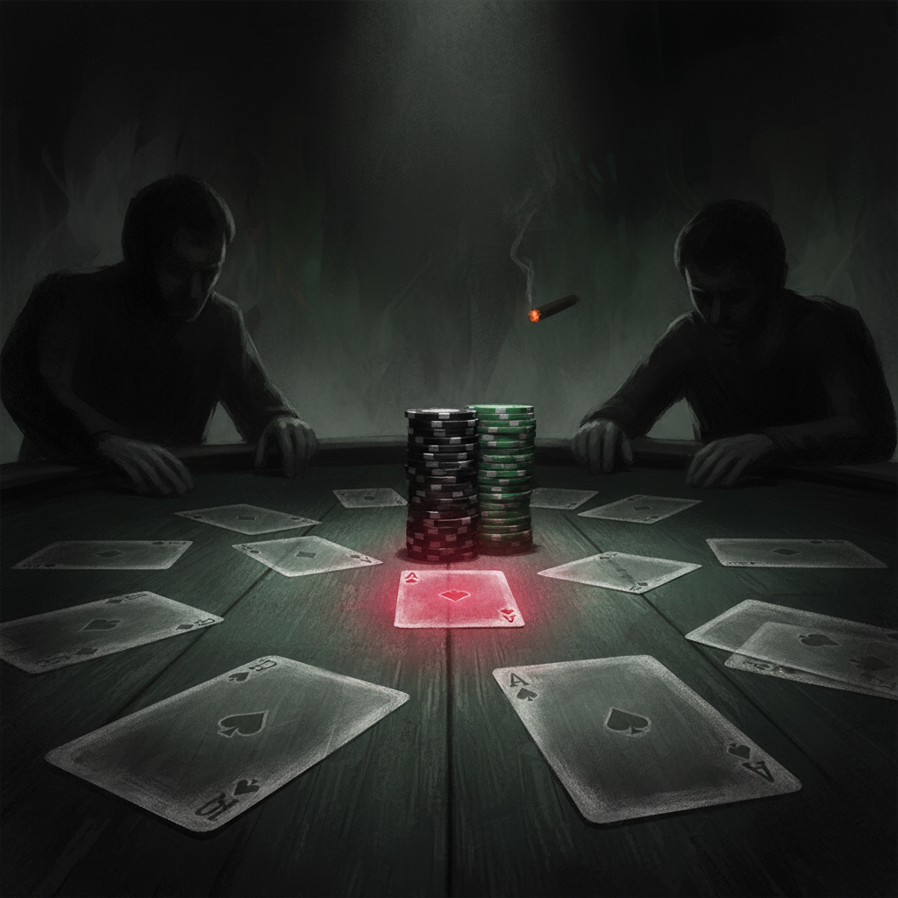

01
You Have No Bluff Plan
A receipts tour through 2,027 flop check-raises.
Sally: Today we use one tournament player's actual numbers to show you something about your own game.
Notes:
Sally: Today we use one tournament player's actual numbers to show you something about your own game.

Slide 2
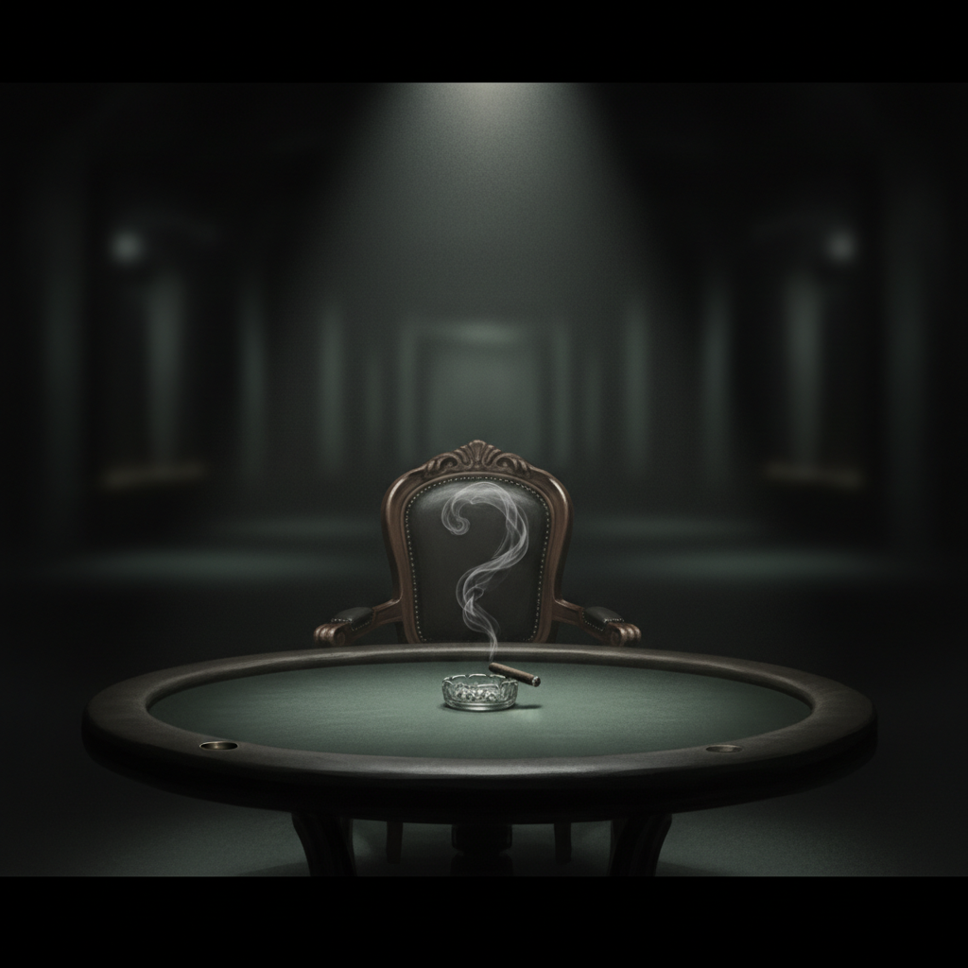
02
How often do you bluff?
When you check-raise the flop with no pair and no draw — pick a number before we move on.
Dieter: Most players guess 20-30%. Almost no one guesses what their actual number is.
Notes:
Dieter: Most players guess 20-30%. Almost no one guesses what their actual number is.

Slide 3
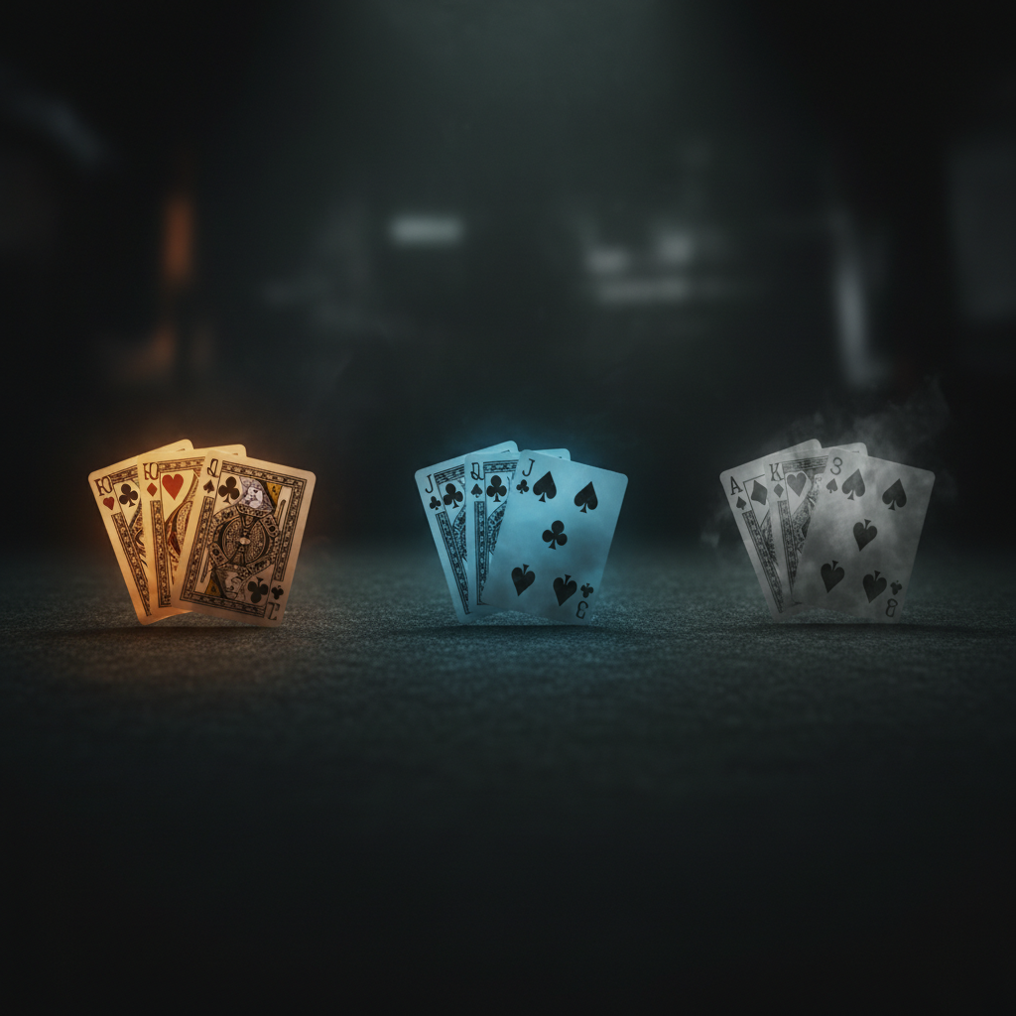
03
What counts as "nothing"
Air = no direct draws. Strict definition.
HAND TYPE | BLUFF?
Pair or better | value
OESD or flush draw | semi-bluff
Gutshot, backdoor, pure miss | AIR
Dieter: A gutshot has 4 outs. It is not a direct draw. The solver treats it as the bluffing slot.
Notes:
Dieter: A gutshot has 4 outs. It is not a direct draw. The solver treats it as the bluffing slot.

Slide 4

04
2,027 flop check-raises.
One tournament player. Real data. Every position. Every flop. Pre-computed by PokerTracker — no estimation.
Sally: This isn't a sample. It's his entire flop check-raise history.
Notes:
Sally: This isn't a sample. It's his entire flop check-raise history.

Slide 5
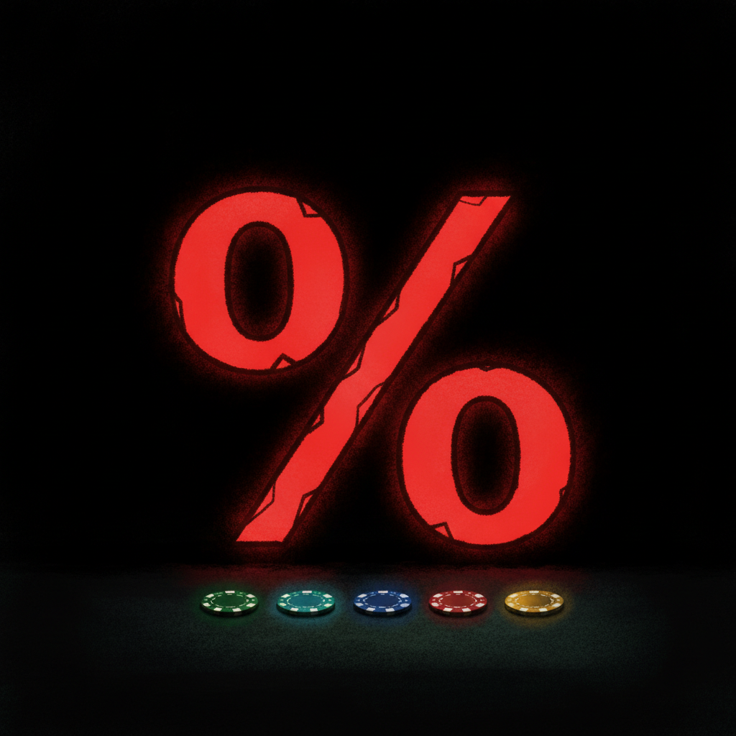
05
0.2%
Pure air check-raises: 4 out of 2,027.
Dieter: Four. Not four percent. Four hands. A balanced range needs 30-40% bluffs. He is at 0.2.
Notes:
Dieter: Four. Not four percent. Four hands. A balanced range needs 30-40% bluffs. He is at 0.2.

Slide 6
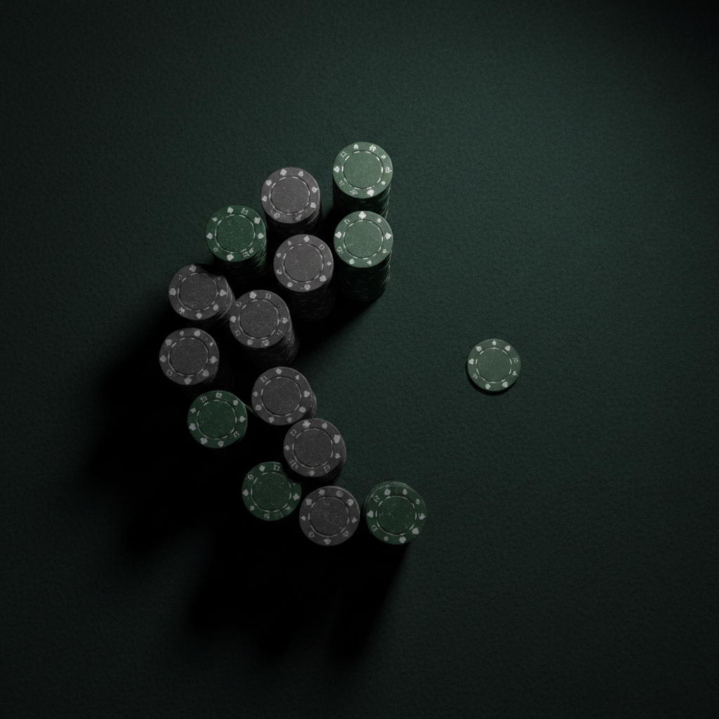
06
The full breakdown
CATEGORY | COUNT | %
MADE pair+ | 1,430 | 70.5%
DIRECT DRAW | 369 | 18.2%
AIR — any kind | 228 | 11.2%
Gutshot only | 89 | 4.4%
Backdoors only | 135 | 6.6%
PURE air | 4 | 0.2%
Sally: Eighty-nine percent of his check-raises are value or semi-bluffs. The bluff inventory is a sliver.
Notes:
Sally: Eighty-nine percent of his check-raises are value or semi-bluffs. The bluff inventory is a sliver.

Slide 7
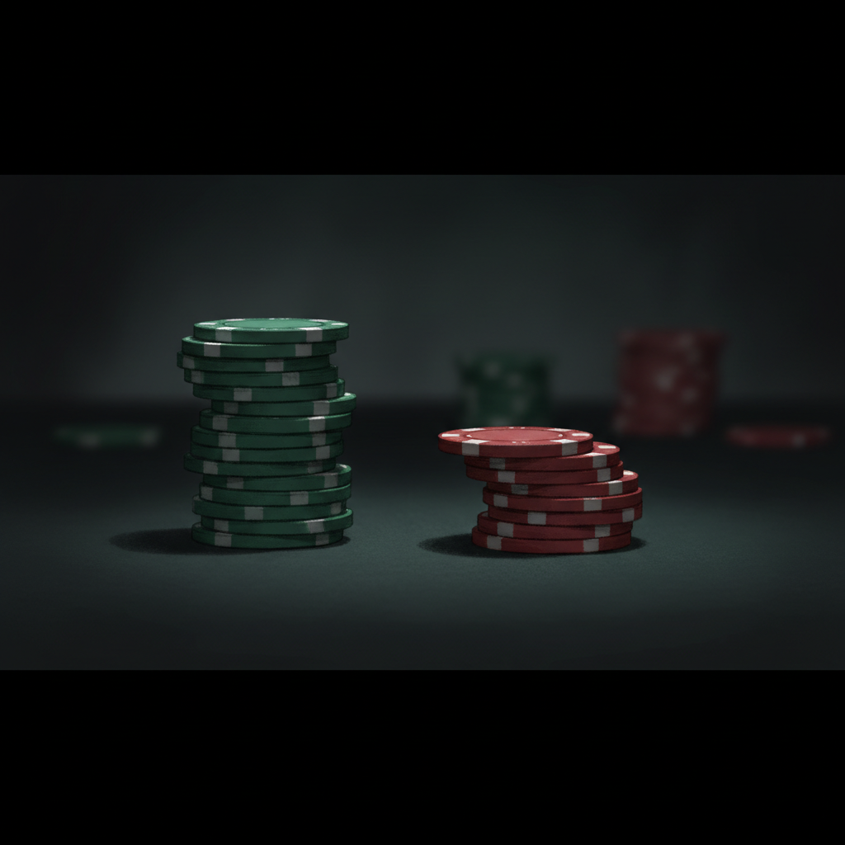
07
What balance requires
Solver
30-40%
You
11.2%
Mathematically exploitable — a thinking opponent stops calling your value hands.
Dieter: Every check-raise is correctly read as value because the bluff slot is empty.
Notes:
Dieter: Every check-raise is correctly read as value because the bluff slot is empty.

Slide 8
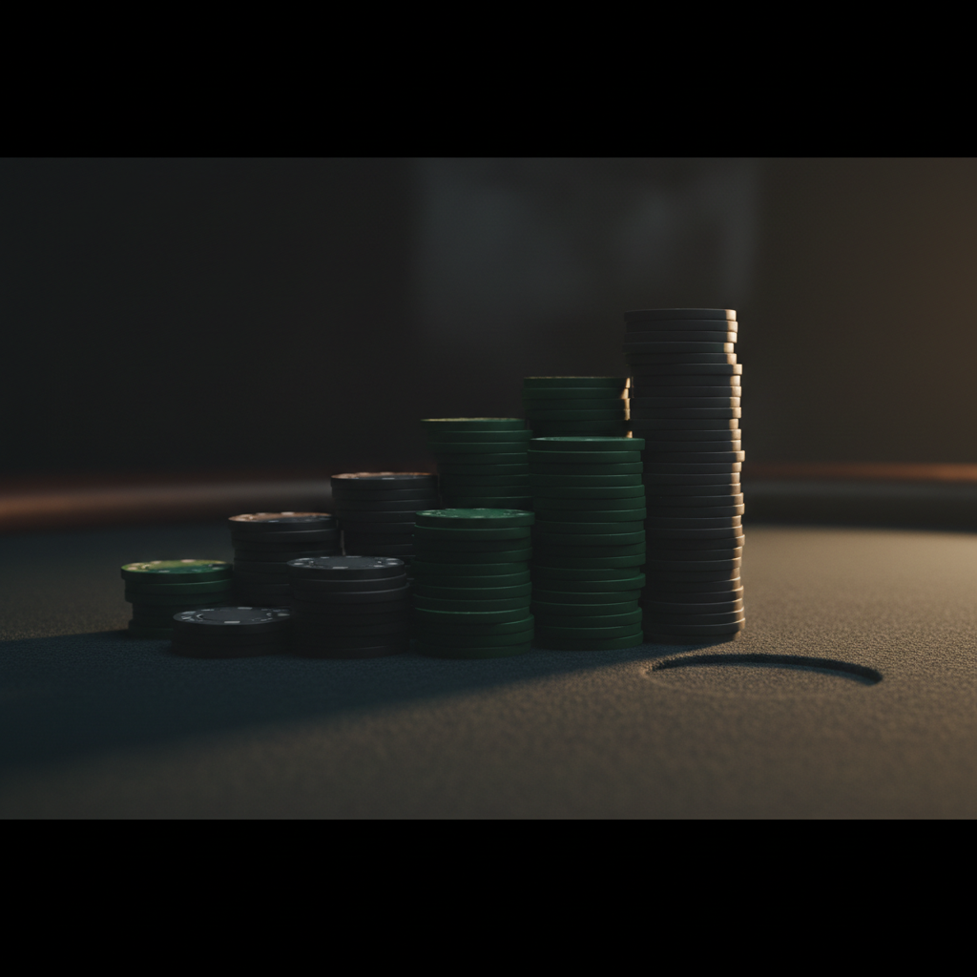
08
The killer slide
FLOP SHAPE | HANDS | AIR %
Run | 855 | 13.6%
Cluster+Crown | 400 | 15.0%
Cluster+Dangler | 393 | 12.5%
Disconnected | 46 | 6.5%
PAIRED | 331 | 0.0%
Dieter: Three hundred thirty-one check-raises on paired boards. Zero air. Not low — zero.
Notes:
Dieter: Three hundred thirty-one check-raises on paired boards. Zero air. Not low — zero.

Slide 9

09
What that looks like face-up
"He check-raised a paired board.
He has it."
Dieter: Opponent does not need a HUD. The frequency is the read.
Notes:
Dieter: Opponent does not need a HUD. The frequency is the read.

Slide 10

10
Bluffs are not desperation.
Bluffs are inventory.
Required stock for a slot the board demands you fill.
Sally: Your bluffs are selected by arithmetic, not by emotion.
Notes:
Sally: Your bluffs are selected by arithmetic, not by emotion.

Slide 11

11
The Marketing Analogy
• Marketing doesn't make money. It's a cost.
• Cut marketing → sales evaporates. Nobody walks in the door.
• Bluffs are marketing. Without them, opponent only enters with the goods.
• Marketing pays for sales. Bluffs pay for value.
Dieter: Bluffs do not produce profit on the bluff itself. They produce profit by making opponent come into the next pot.
Notes:
Dieter: Bluffs do not produce profit on the bluff itself. They produce profit by making opponent come into the next pot.

Slide 12

12
Three lanes
LANE | ACTION | YOU PLAY IT?
1 | Best hand, bet, get called | Always
2 | Worst hand, bet, opponent folds | Almost never
3 | Worst hand, bet, get called (pays for lane 1) | Never
Dieter: This player is driving in one lane on a three-lane road.
Notes:
Dieter: This player is driving in one lane on a three-lane road.

Slide 13
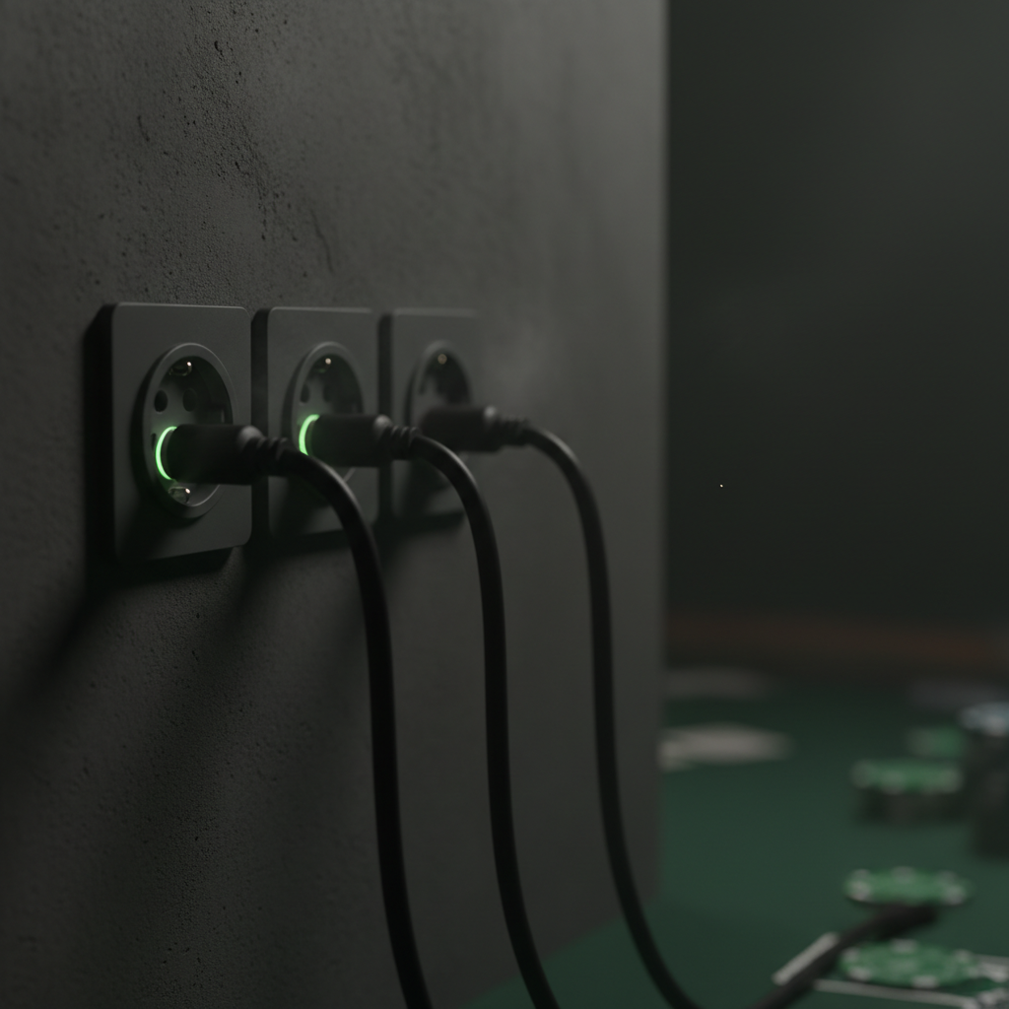
13
The slot has to be filled
Made hands are busy → filling value slot
Draws are busy → filling semi-bluff slot
Only inventory left: air
Dieter: The slot is mathematical. The inventory is what's left. They meet.
Notes:
Dieter: The slot is mathematical. The inventory is what's left. They meet.

Slide 14
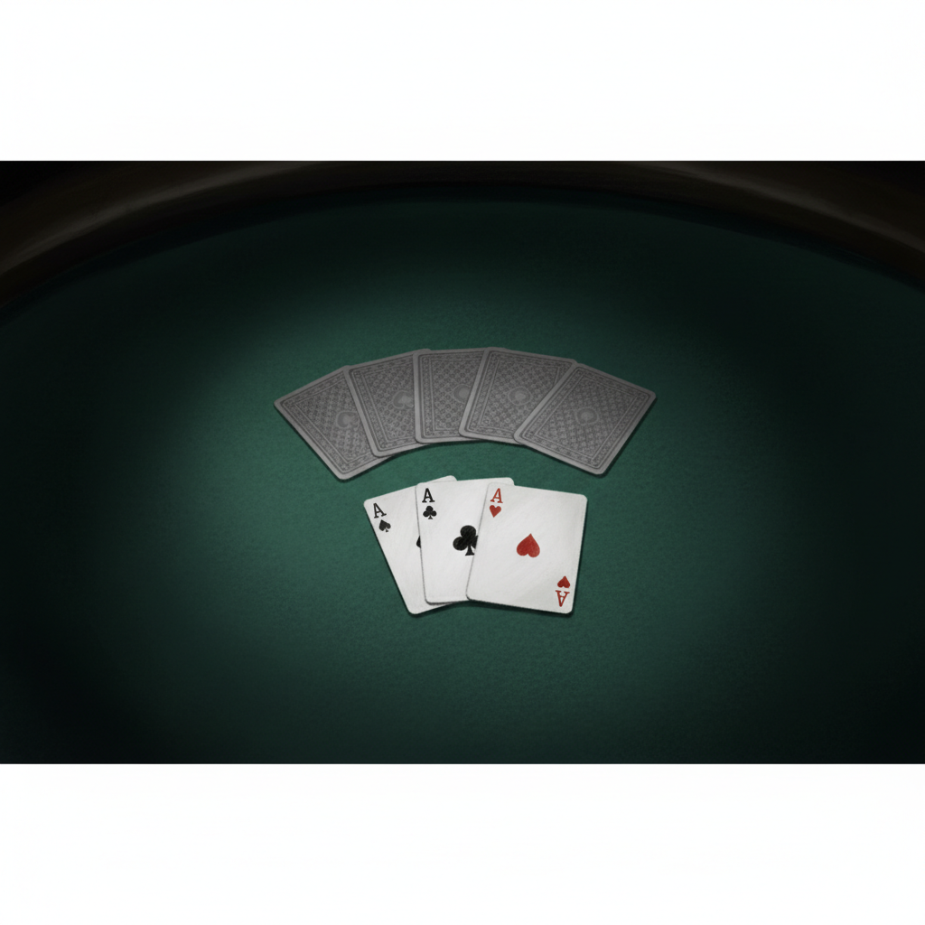
14
What a bluff plan looks like
Low paired flop (552), you defended pre, face 20% c-bet. Your X/R bluff slot:
• Suited overcards with backdoors
• Pocket pairs below the board pair
• Occasional suited connector
COMPOSITION • Not a frequency target. A swap list.
Dieter: You do not aim to check-raise 30%. You aim to check-raise these specific hands.
Notes:
Dieter: You do not aim to check-raise 30%. You aim to check-raise these specific hands.

Slide 15
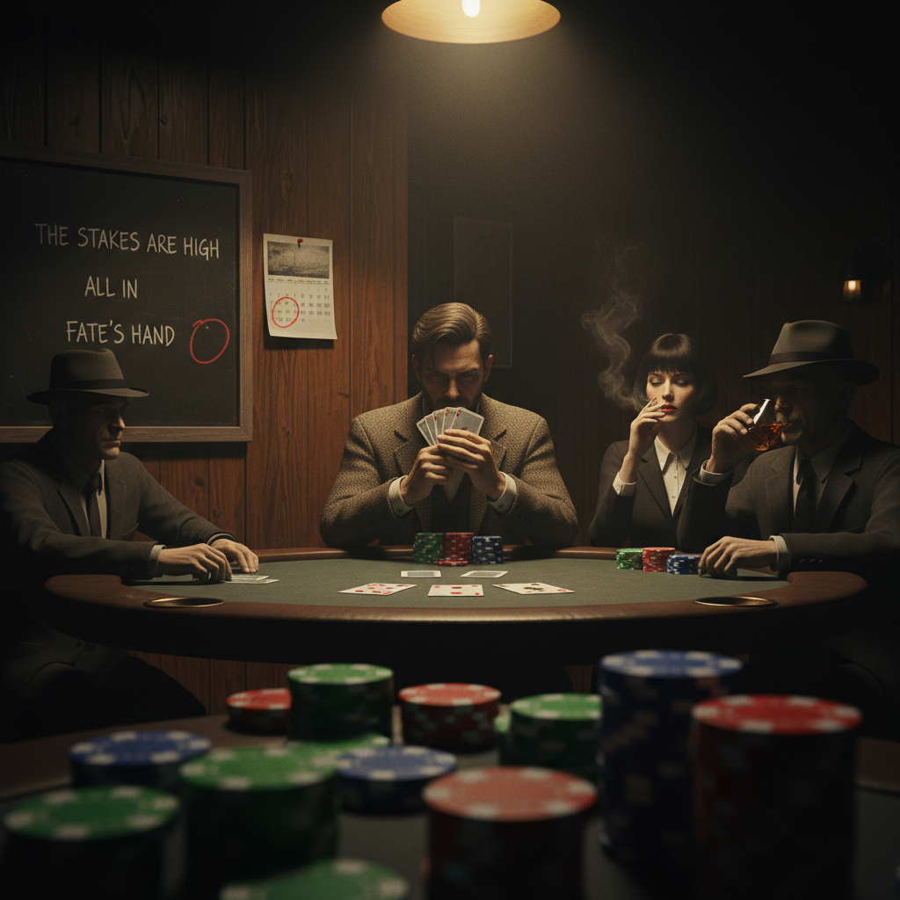
15
Assignment this week
1. When you defend pre + flop comes paired + face a c-bet → default is not fold.
2. Suited overcards or pocket pair below board → check-raise.
3. Expect to fold to a shove. That's the protocol, not weakness.
Sally: You're depositing into the bluff bank so opponent pays your aces next time.
Notes:
Sally: You're depositing into the bluff bank so opponent pays your aces next time.

Slide 16
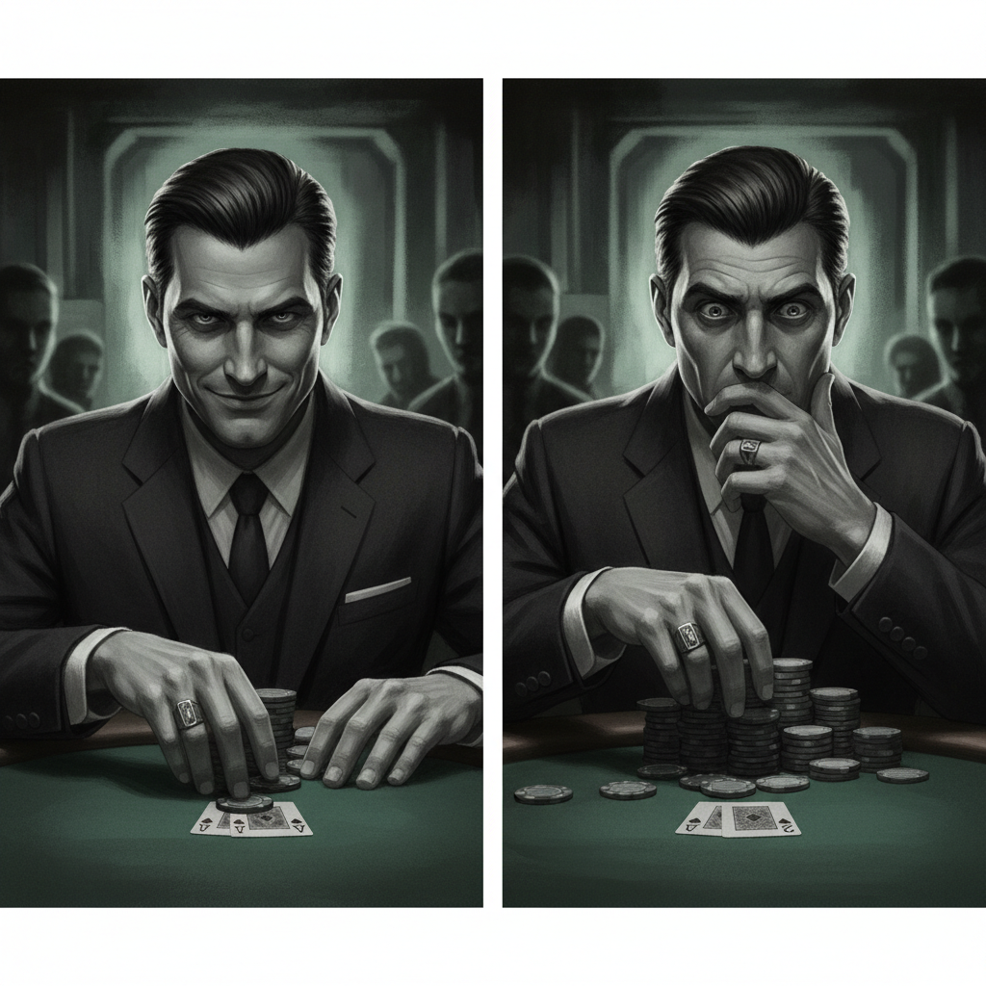
16
What changes for villain
TODAY
DAY 90
C-bets paired flops freely.
Knows your X/R = always value.
Has to consider you might be at it.
C-bets shrink. Value gets paid more.
Dieter: It pays you over the next thousand hands as opponent adjusts their model of you.
Notes:
Dieter: It pays you over the next thousand hands as opponent adjusts their model of you.

Slide 17
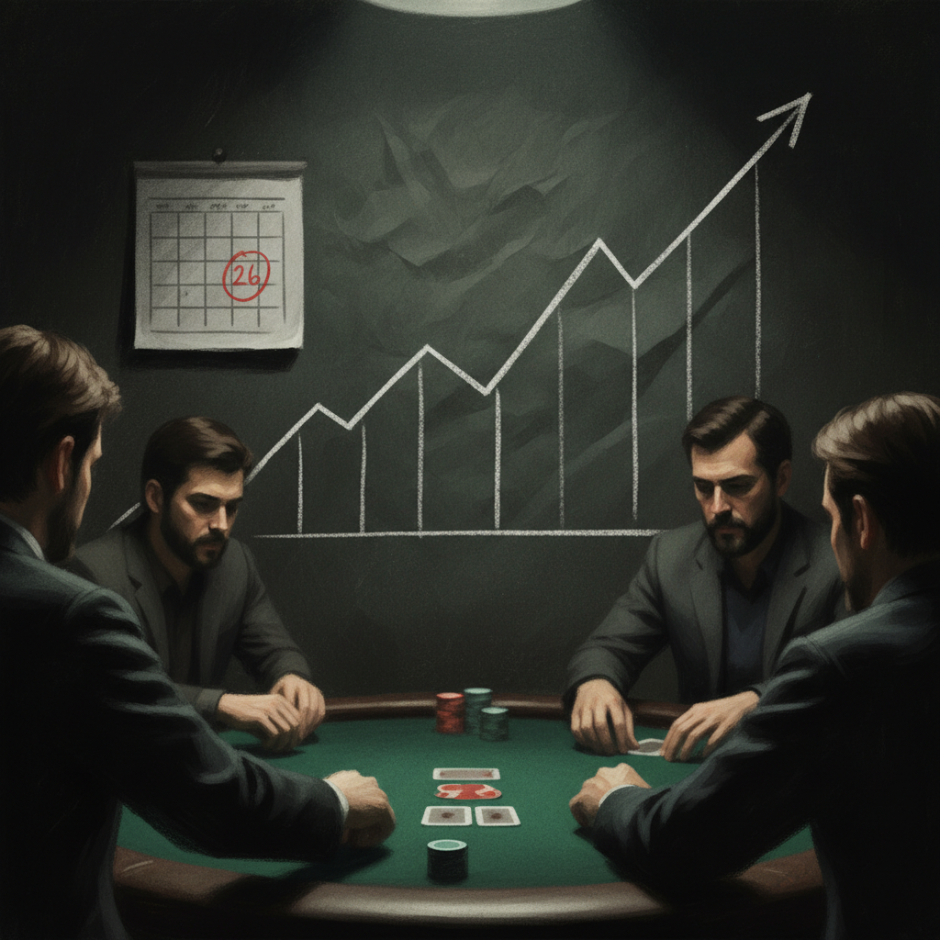
17
The receipts
Re-run this exact query in 90 days:
• Paired-board X/R air % should be > 0
• Overall air % climbing toward 25-30%
• BB-defense bb/100 should be following
Dieter: If the numbers do not move, the deprogramming did not take.
Notes:
Dieter: If the numbers do not move, the deprogramming did not take.

Slide 18
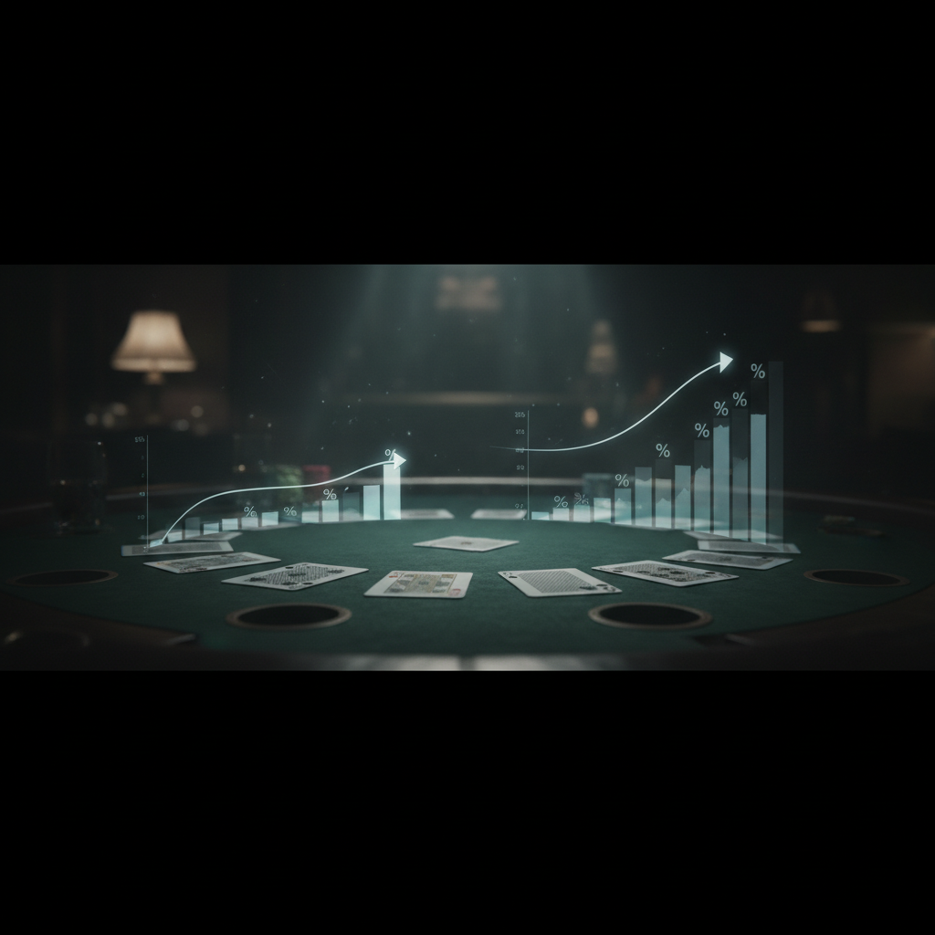
18
Your range,
not your hand.
Cards are private. Range is public.
Bluffs are how you keep the range honest.
Dieter: Marketing pays for sales. Bluffs pay for value.
Notes:
Dieter: Marketing pays for sales. Bluffs pay for value.

